Slide 1


Climate Change:
Simple, Serious, Solvable
Scott Denning
Director of Education, CMMAP
Atmospheric Science, CSU
Email Scott.Denning@ColoState.edu for a copy of this presentation

Slide 2
Simple

Slide 3


Ever Wonder Why?
Day is warmer than night
Summer is warmer than winter
Phoenix is warmer than Fargo

Slide 4

Heat Budgets
Heat in
Heat in
Heat out
Heat out

Slide 5
Dancing Molecules and Heat Rays!
Nearly all of the air is made of oxygen (O₂) and nitrogen (N₂) in which two atoms of the same element share electrons
Infrared (heat) energy radiated up from the surface can be absorbed by these molecules, but not very well
O
O
N
N
Diatomic molecules can vibrate back and forth like balls on a spring, but the ends are identical

Slide 6
Dancing Molecules and Heat Rays!
Carbon dioxide (CO₂) and water vapor (H₂O) are different!
They have many more ways to vibrate and rotate, so they are very good at absorbing and emitting infrared (heat) radiation
O
C
O
O
H
H
Molecules that have many ways to wiggle are called “Greenhouse” molecules
Absorption spectrum of CO2 was measured by John Tyndall in 1863

Slide 7


Slide 8
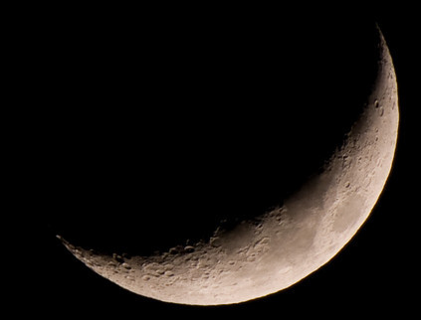
Spring Night
in Colorado
radiation
emitted
by soil
5 PM surface temperature = 15 °C = 60 °F
390 W m⁻²
4 inches
= 10 cm

Slide 9
Spring Night
in Colorado
radiation
emitted
by soil
6 AM surface temperature = -60 °C = -78 °F
9 PM surface temperature = 15 °C = 60 °F
390 W m⁻²
4 inches
= 10 cm

Slide 10
Spring Night
in Colorado
radiation
emitted
by air
radiation
emitted
by soil
340 W m⁻²
6 AM surface temperature = 5 °C = 40 °F
390 W m⁻²
4 inches
= 10 cm

Slide 11
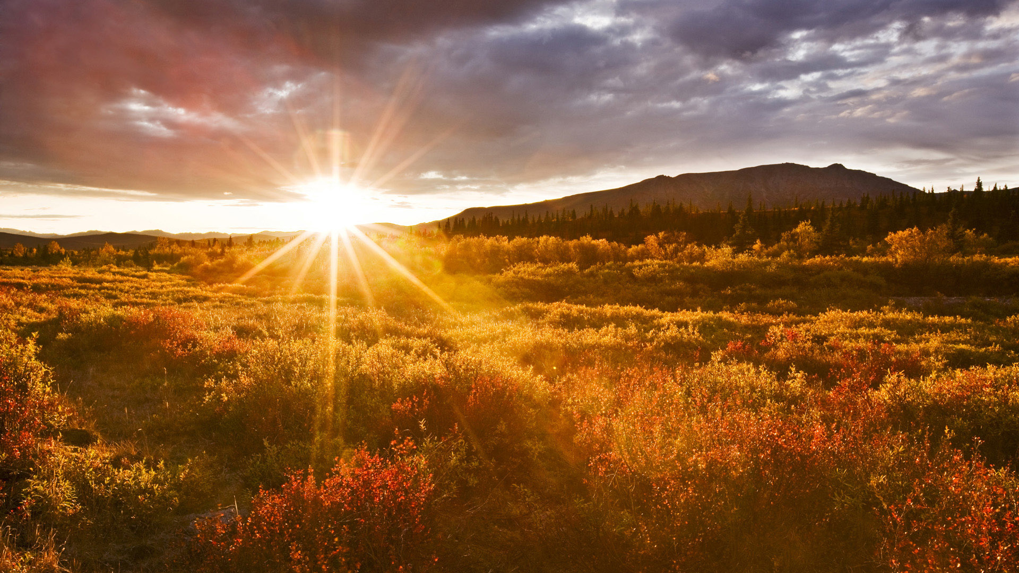
The strongest evidence for the
Greenhouse Effect
is that we can
survive night!

Slide 12


Common Sense
1 m
Doubling CO₂ would add 4 watts to every square meter of the surface of the Earth, 24/7
Doing that would make the surface warmer
This was known before light bulbs were invented!
4 Watts
1 m
John Tyndall, January 1863

Slide 13

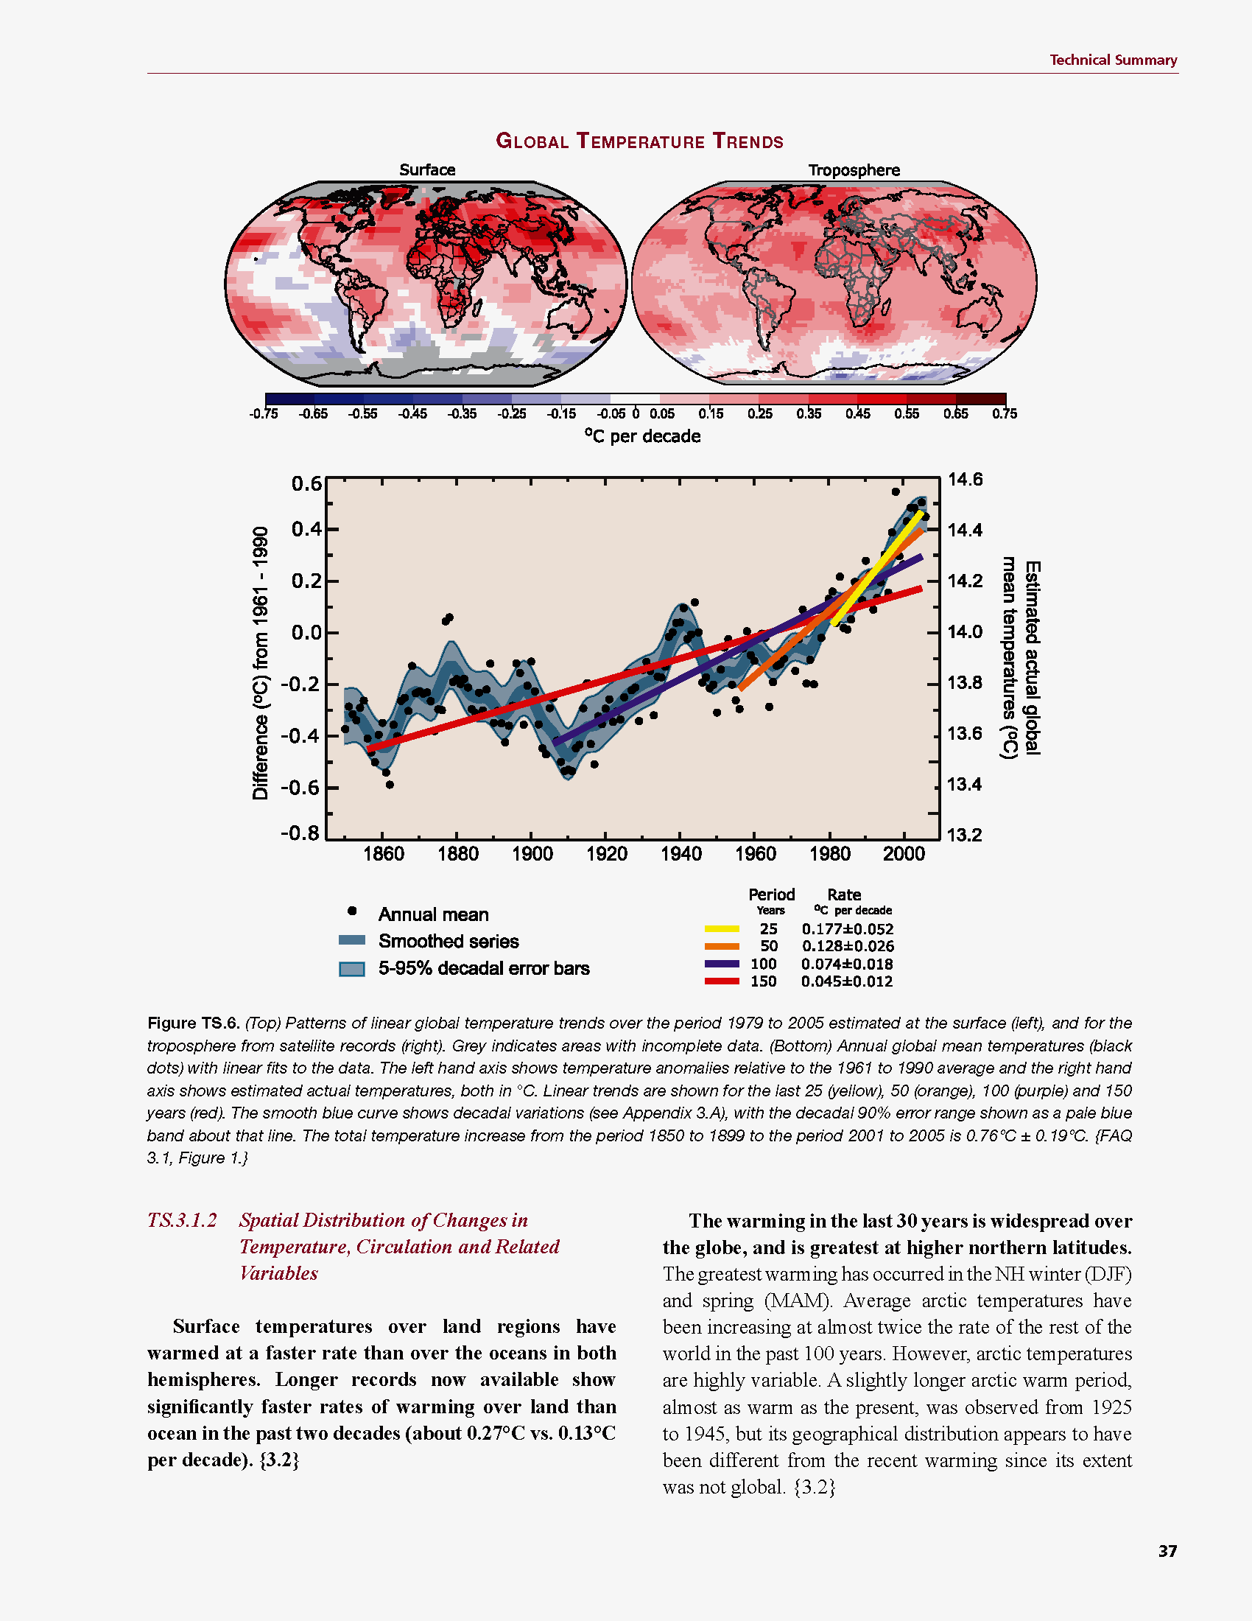
Common Myth #1
“Scientists expect a warmer future because it’s been warming up recently”
WRONG!
It’s because we know that when we add heat to things, they warm up

Slide 14
Cause and Effect
Forcing
Watts per
square meter
Response
degrees
Celsius or F
Response
Sensitivity =
Forcing
degrees per Watt m⁻²

Slide 15

Learning from the Past
Geologic past
(100’s of millions of years)
Deglaciation analog
(18,000 years ago to preindustrial time)
Last Millennium analog
(Medieval Warm Period to Little Ice Age)
Modern Climate Record
(20th Century changes)
The further back we go, the less data we have to work with.
Using modern data, we have only brief transients to study.

Slide 16
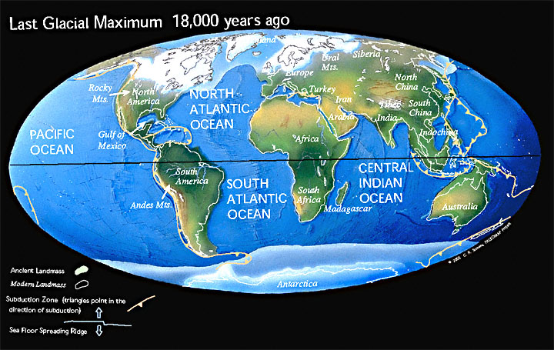
Ice Age World
High albedo
Low CO₂

Slide 17
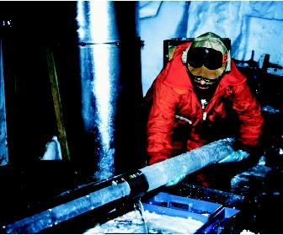
CO₂ and the Ice Ages
Over the past 420,000 years atmospheric CO₂ has varied between 180 and 280 ppm, beating in time with the last four glacial cycles
CO₂
370 ppm in 2000
ice
ice
ice
ice
Vostok (400k yr) Ice Core data (Petit et al, 1999)

Slide 18
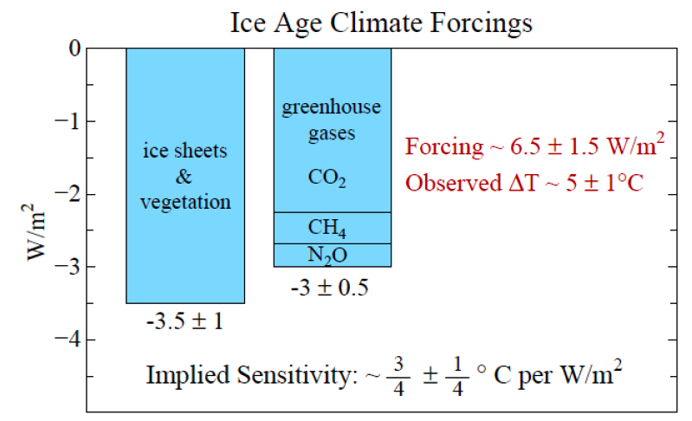
Climate Forcing
Source: Hansen and Sato (2011)

Slide 19
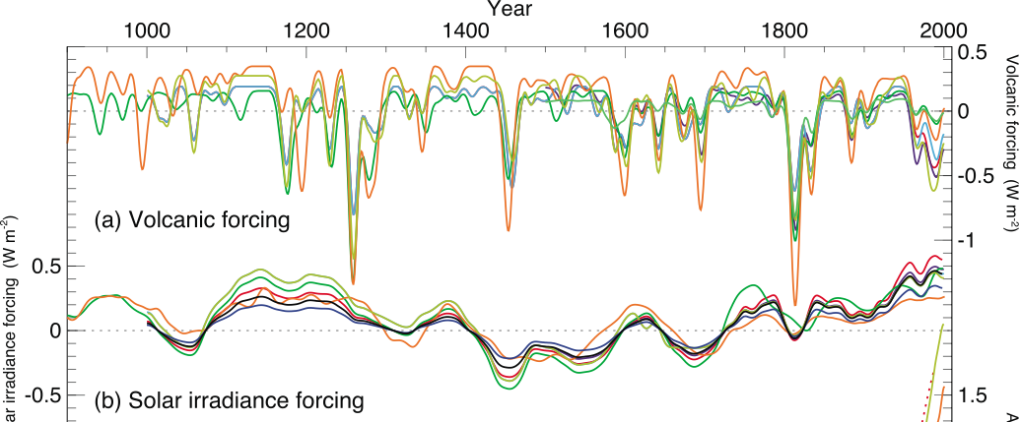
Reconstructed Climate Forcing Since 1000 AD
1816
1991
0.5
Pinatubo
Tambora
“year w/out
a summer”
1.0 W m⁻²
Volcanic particles scatter a lot of sunlight, but not for long
Solar radiation changes by just a little, over centuries

Slide 20

The Past 2000 Years
0.8 °C

Slide 21
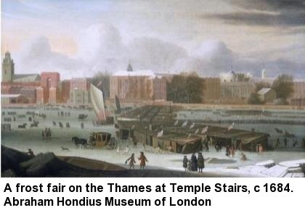
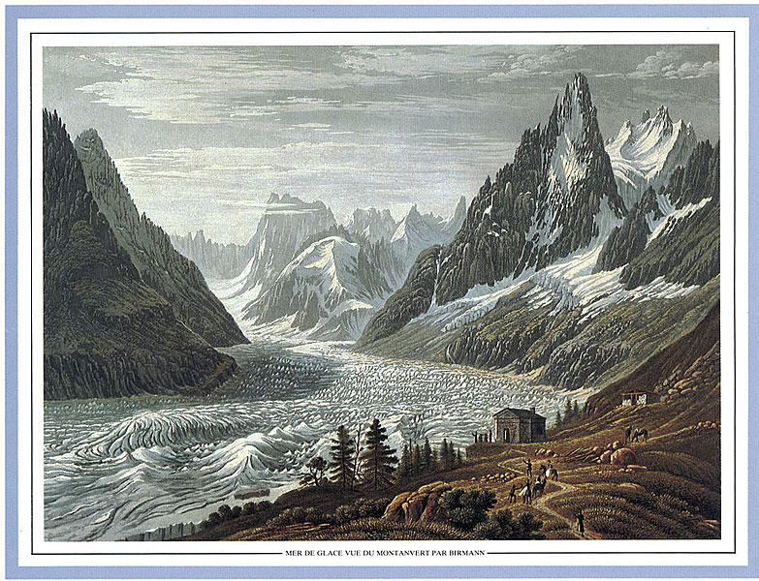
Second Millennium Analog
Cooling from Medieval Warm Period to
Little Ice Age ~ 0.8 °C
Solar forcing ~ 1.0 W m⁻²
(somewhat complicated
by volcanic forcing)
Total climate sensitivity
0.8 °C per (W m⁻²)
1826

Slide 22
Climate Sensitivity to enhanced CO₂
Volcanoes, Last Millennium, Deglaciation
all around 0.8 °C of warming per (W m⁻²)
Each doubling of CO₂
adds 4 Watts per square meter
So expect about
(4 W m⁻²) x (0.8 °C per (W m⁻²))
= 3 °C per doubling of CO₂

Slide 23
CO₂ and the Future
Over the past 420,000 years atmospheric CO₂ has varied between 180 and 280 parts per million, beating in time with the last four glacial cycles
Since the Industrial Revolution, CO₂ has risen very rapidly
If China & India develop using 19th Century technology, CO₂ will reach 1000 ppm in this century
CO₂
1000 ppm in 2100
400 ppm in 2014
ice
ice
ice
ice
Vostok (400k yr) Ice Core data (Petit et al, 1999)
You ain’t seen nothing yet!

Slide 24
Serious

Slide 25


How much warmer?
Land vs ocean!
North vs South
Global mean
warming of 2º to 5º C
North American
warming of 3º to 6º C
= 5º to 11º F
Arctic warming of
8º to 14º F
Low
Emissions
Moderate
Emissions
High
Emissions
Rainfall? Agriculture?
Water demand? Tourism?
Mass immigration?

Slide 26

Where is it 10°F Warmer
“on average?”
Denver ➔
Amarillo
Grand Junction ➔ Tucson
Illinois ➔
Mississippi
Water? Crops?
Real Estate? Health?

Slide 27
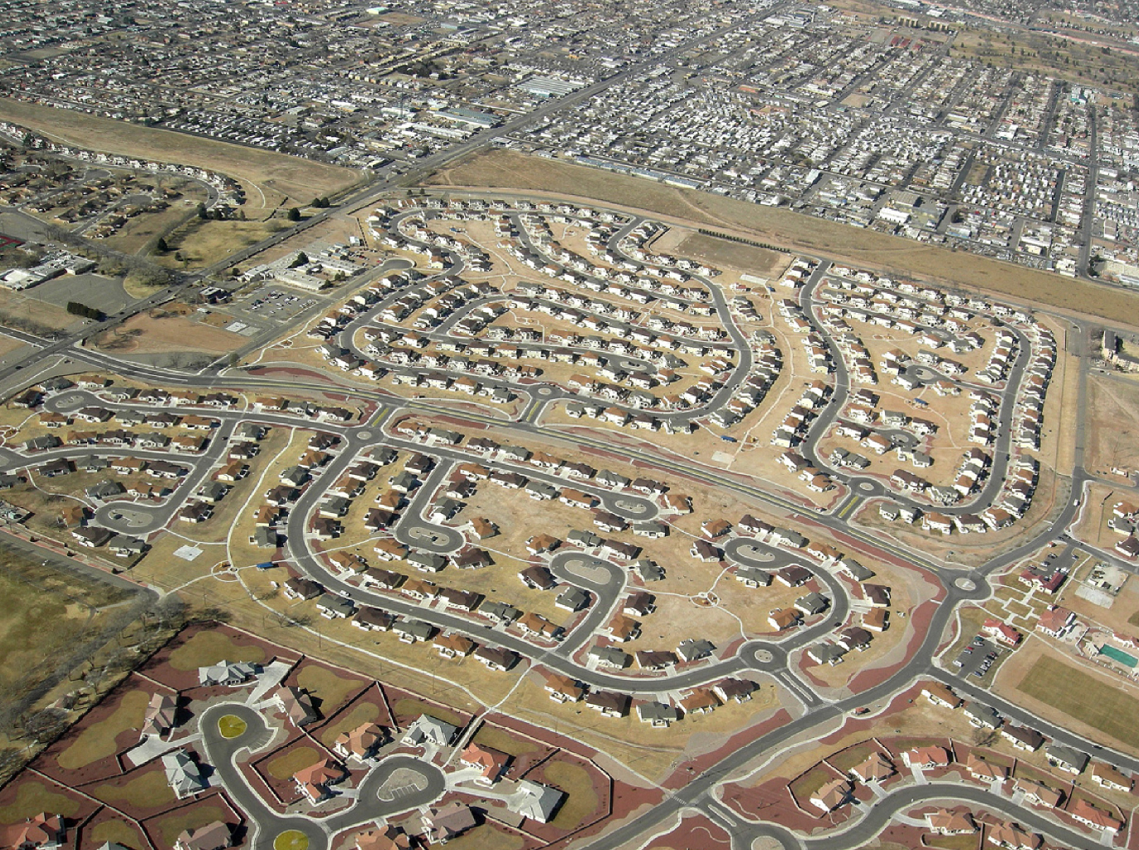
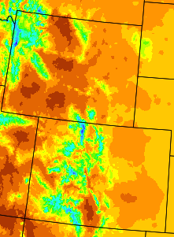
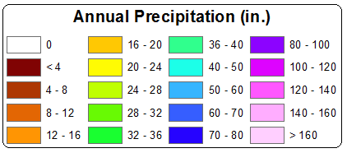
A Region On the Edge
Much of our region already receives only marginal precipitation
Just enough snow to support forests and reservoirs
Just enough irrigation water to support agriculture
Just enough water to support 5.3 million people

Slide 28
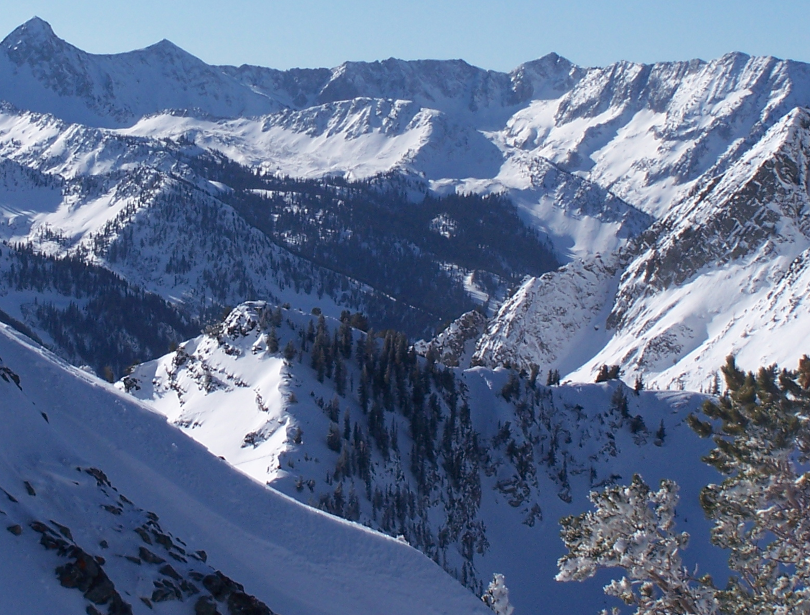
Snowpack

Slide 29
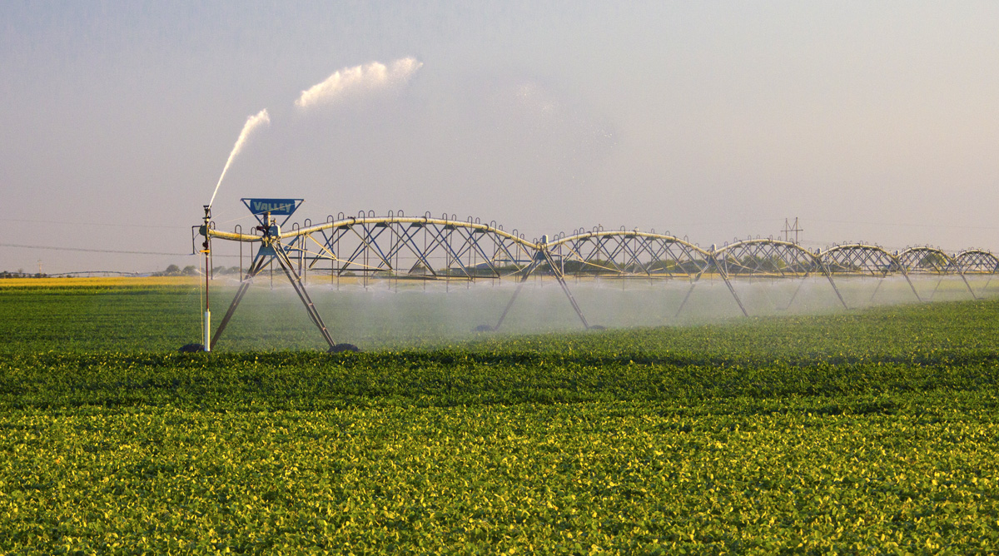
Water Budgets
Evaporative demand increases w/ temperature
In
Out
Drought is the running sum
of water out minus water in

Slide 30
Droughts Past & Future
Dust Bowl
Medieval Megadroughts

Slide 31

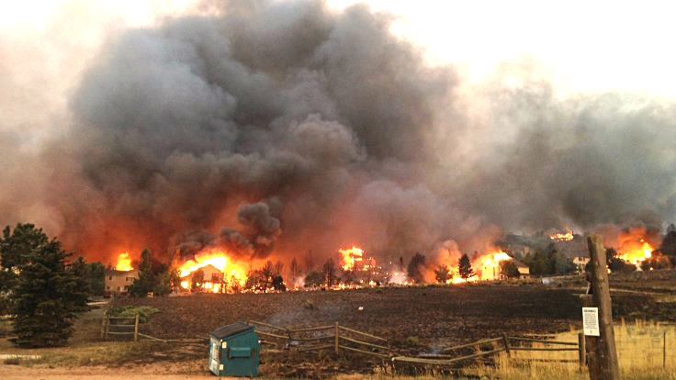
Warming Promotes Wildfire
Warmer air increases evaporative demand on forests
Longer warm season depletes soil moisture
More frequent extremely hot, dry, windy days when fires are uncontrollable
Projected Increase in Area Burned
656%
656%
NRC 2011

Slide 32
Economic Development
Urban water use in Colorado currently about 17% of total
Colorado projects 60% population growth by 2050, to 8 million
Combined with increased ET, this will produce tremendous pressure for increased diversion to cities

Slide 33
Past & Future Sea Level Changes
Reconstructions, modern tide gauges, satellite altimetry, and models of the future
Does not include ice sheet dynamics

Slide 34
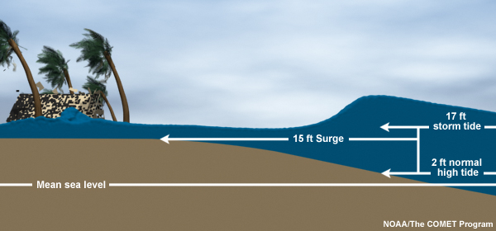
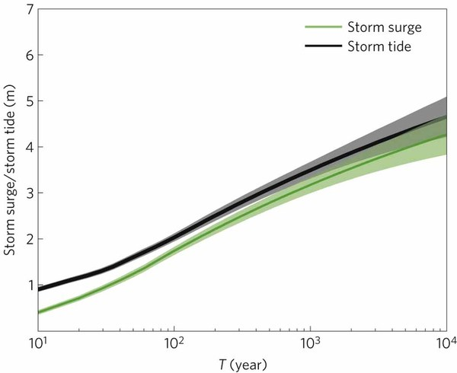
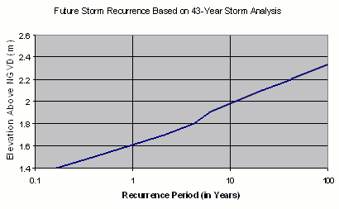
Storm Surge Frequency
Big storms push a “dome” of water onto land
Small storm surges happen
a lot
Big storm surges are more rare
Huge surges extremely rare
18
15
12
height above sea level (feet)
9
6
Coastal Flooding
Rockaway Beach, NYC
3
10 100 1000 10000
How often (years)

Slide 35

Coastal
Flooding
Sea level rise shifts the line up
Floods of a given depth happen more often
What was a
100-year flood becomes a
10-year flood!
Rockaway Beach, NYC
12
9
height above sea level (feet)
6
flooded
subway
system
3
10
100
1000
how often (years)

Slide 37
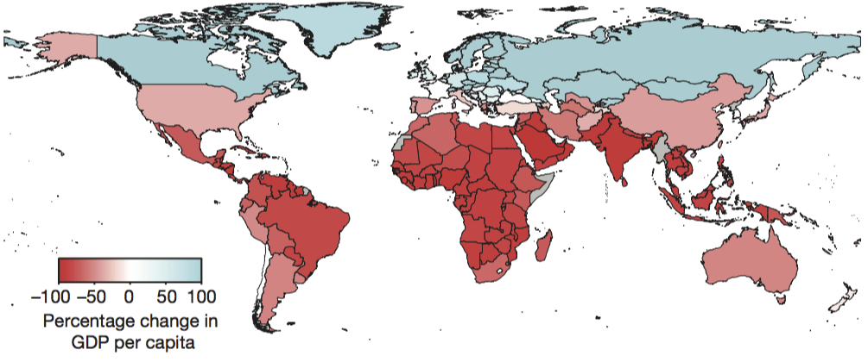
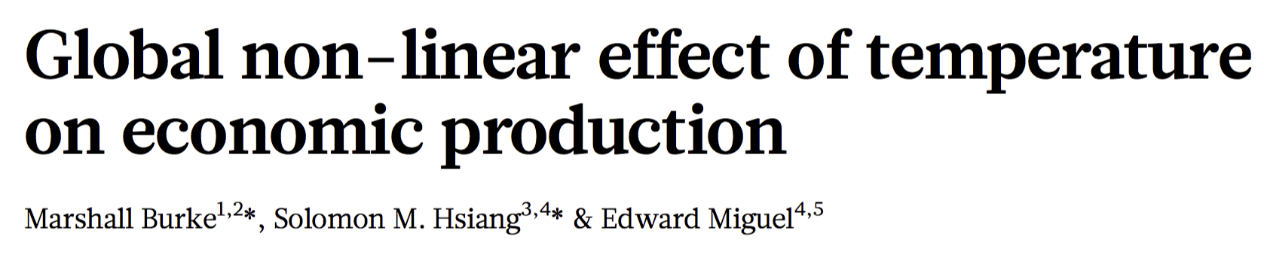

Climate Change Costs
Global 25% decrease

Slide 38
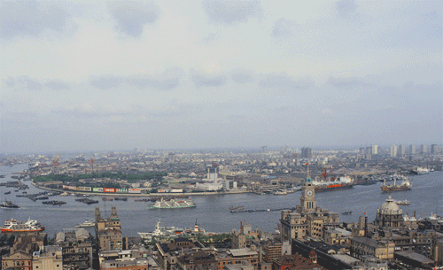
Billions and Billions
Shanghai 1991 and 2012
Currently 7 billion people on Earth
but only 1 billion use lots of energy
Rapid development to 4 billion
energy users over coming decades
Population growth only 30% but
energy growth 300% by 2100

Slide 39
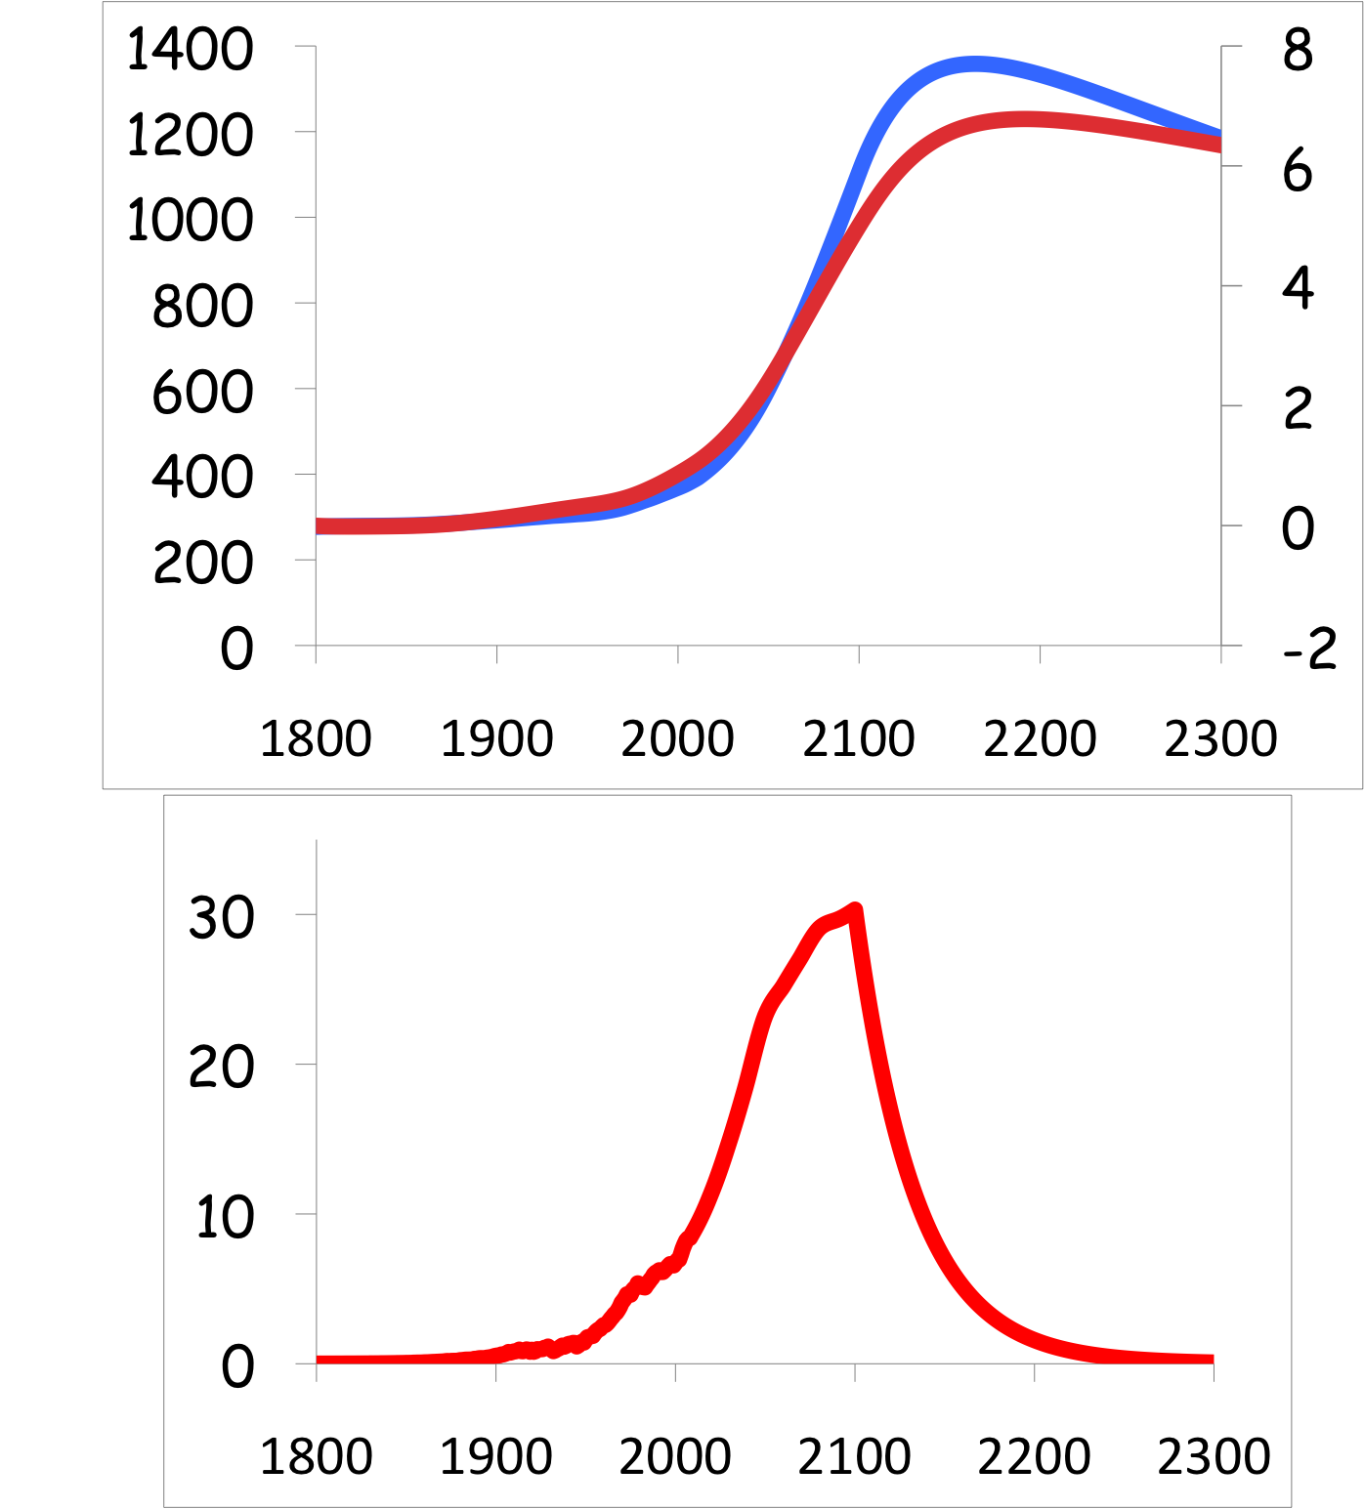
Common Myth #2
“When we reduce or stop burning fossil fuel, CO₂ will go away and things will go back to normal”
CO₂
If China and India industrialize with coal, CO₂ will rise to 4x preindustrial
Extra CO₂ will last for millennia after coal is gone
CO₂ (ppm)
warming
Warming (Celsius)
you are
here
emissions
GtC/yr
year
Thermostat only turns one way!

Slide 40
Solvable

Slide 41

Efficient Architects!
$4.5 TRILLION

Slide 42
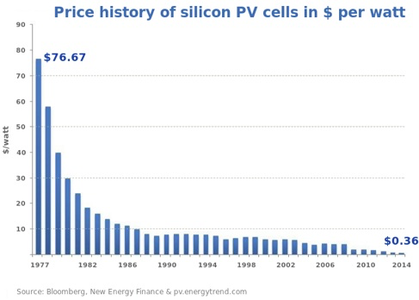
Price of Solar
PV Cells ($/watt)
Price has fallen by factor of 200 since I graduated from high school
Factor of 5 since 2008
Now as cheap or cheaper than coal or gas
Drop in 1970s
Flatter in1990s

Slide 43
Solar Resources
US vs Germany
German electricity
4% wind & solar in 2000
28% wind & solar in 2014

Slide 44
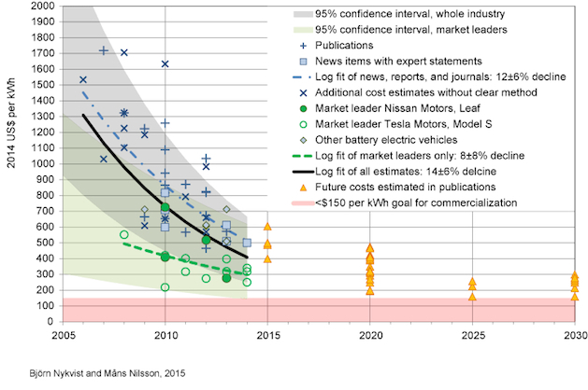
Lithium-Ion Batteries
Much cheaper than expected
a few years ago!

Slide 45


Costs
Conversion to 100% noncarbon energy will cost about
1% of GDP
That’s about what it cost to retrofit all the world’s cities with indoor plumbing a century ago …
It was worth it!

Slide 46
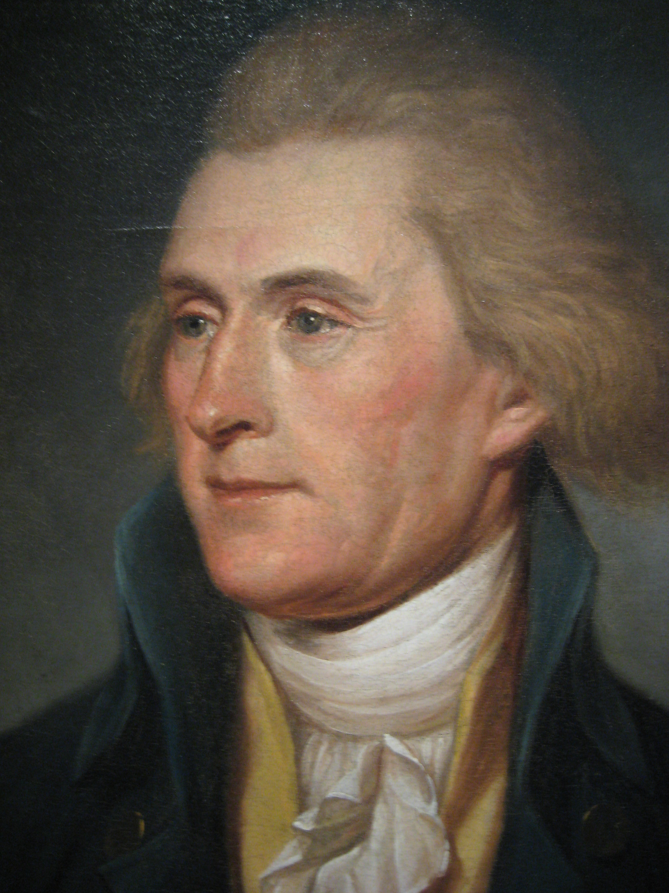
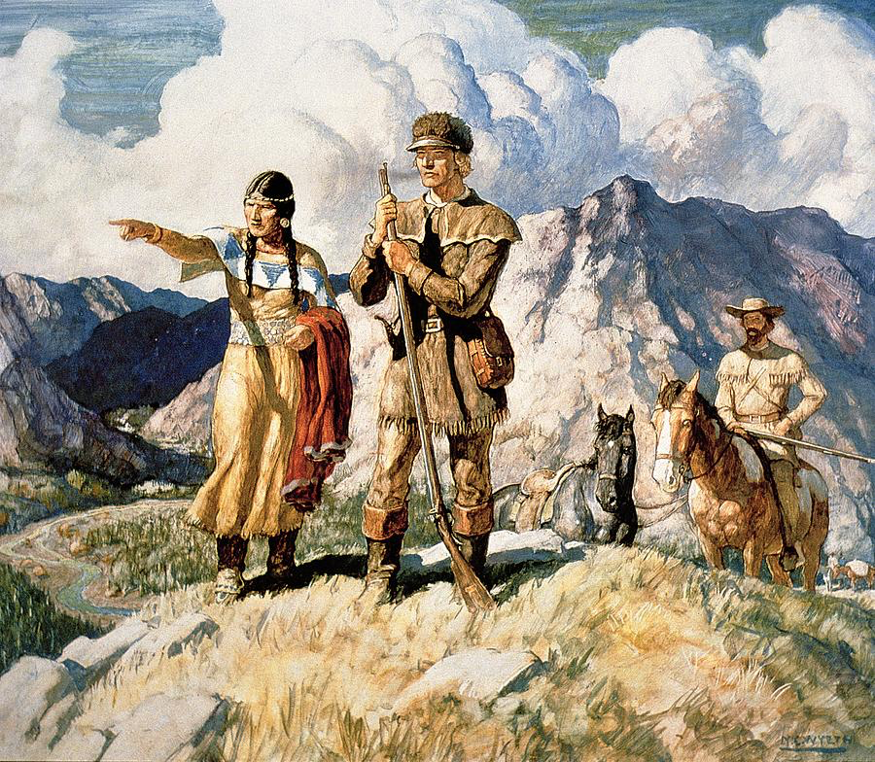
Imagine it’s 1800 …
Lewis and Clarke with Sacajawea
President Thomas Jefferson

Slide 47

Imagine it’s 1800 …

Slide 48
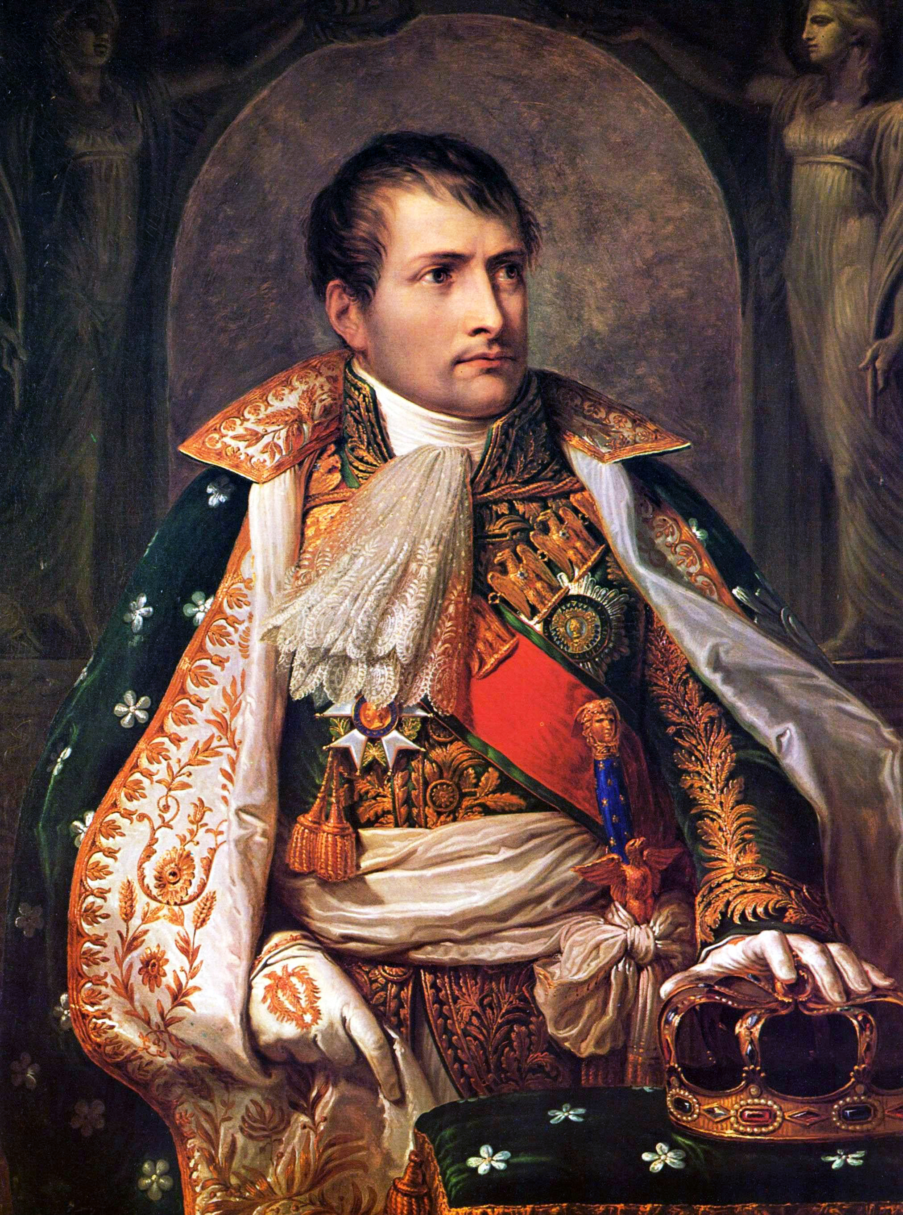
Imagine it’s 1800, and you’re in charge …
Napoleon Bonaparte

Slide 49
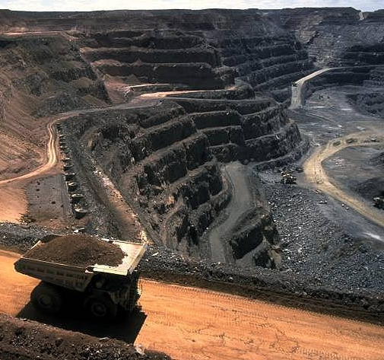
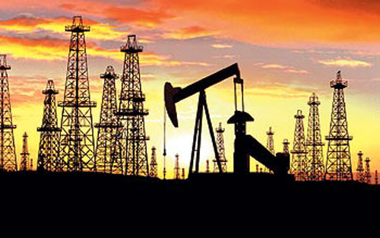
Imagine it’s 1800, and you’re in charge …
Somebody presents you with a grand idea for transforming the world economy:
  Dig 8 billion tons of carbon out of the ground every year

Slide 50
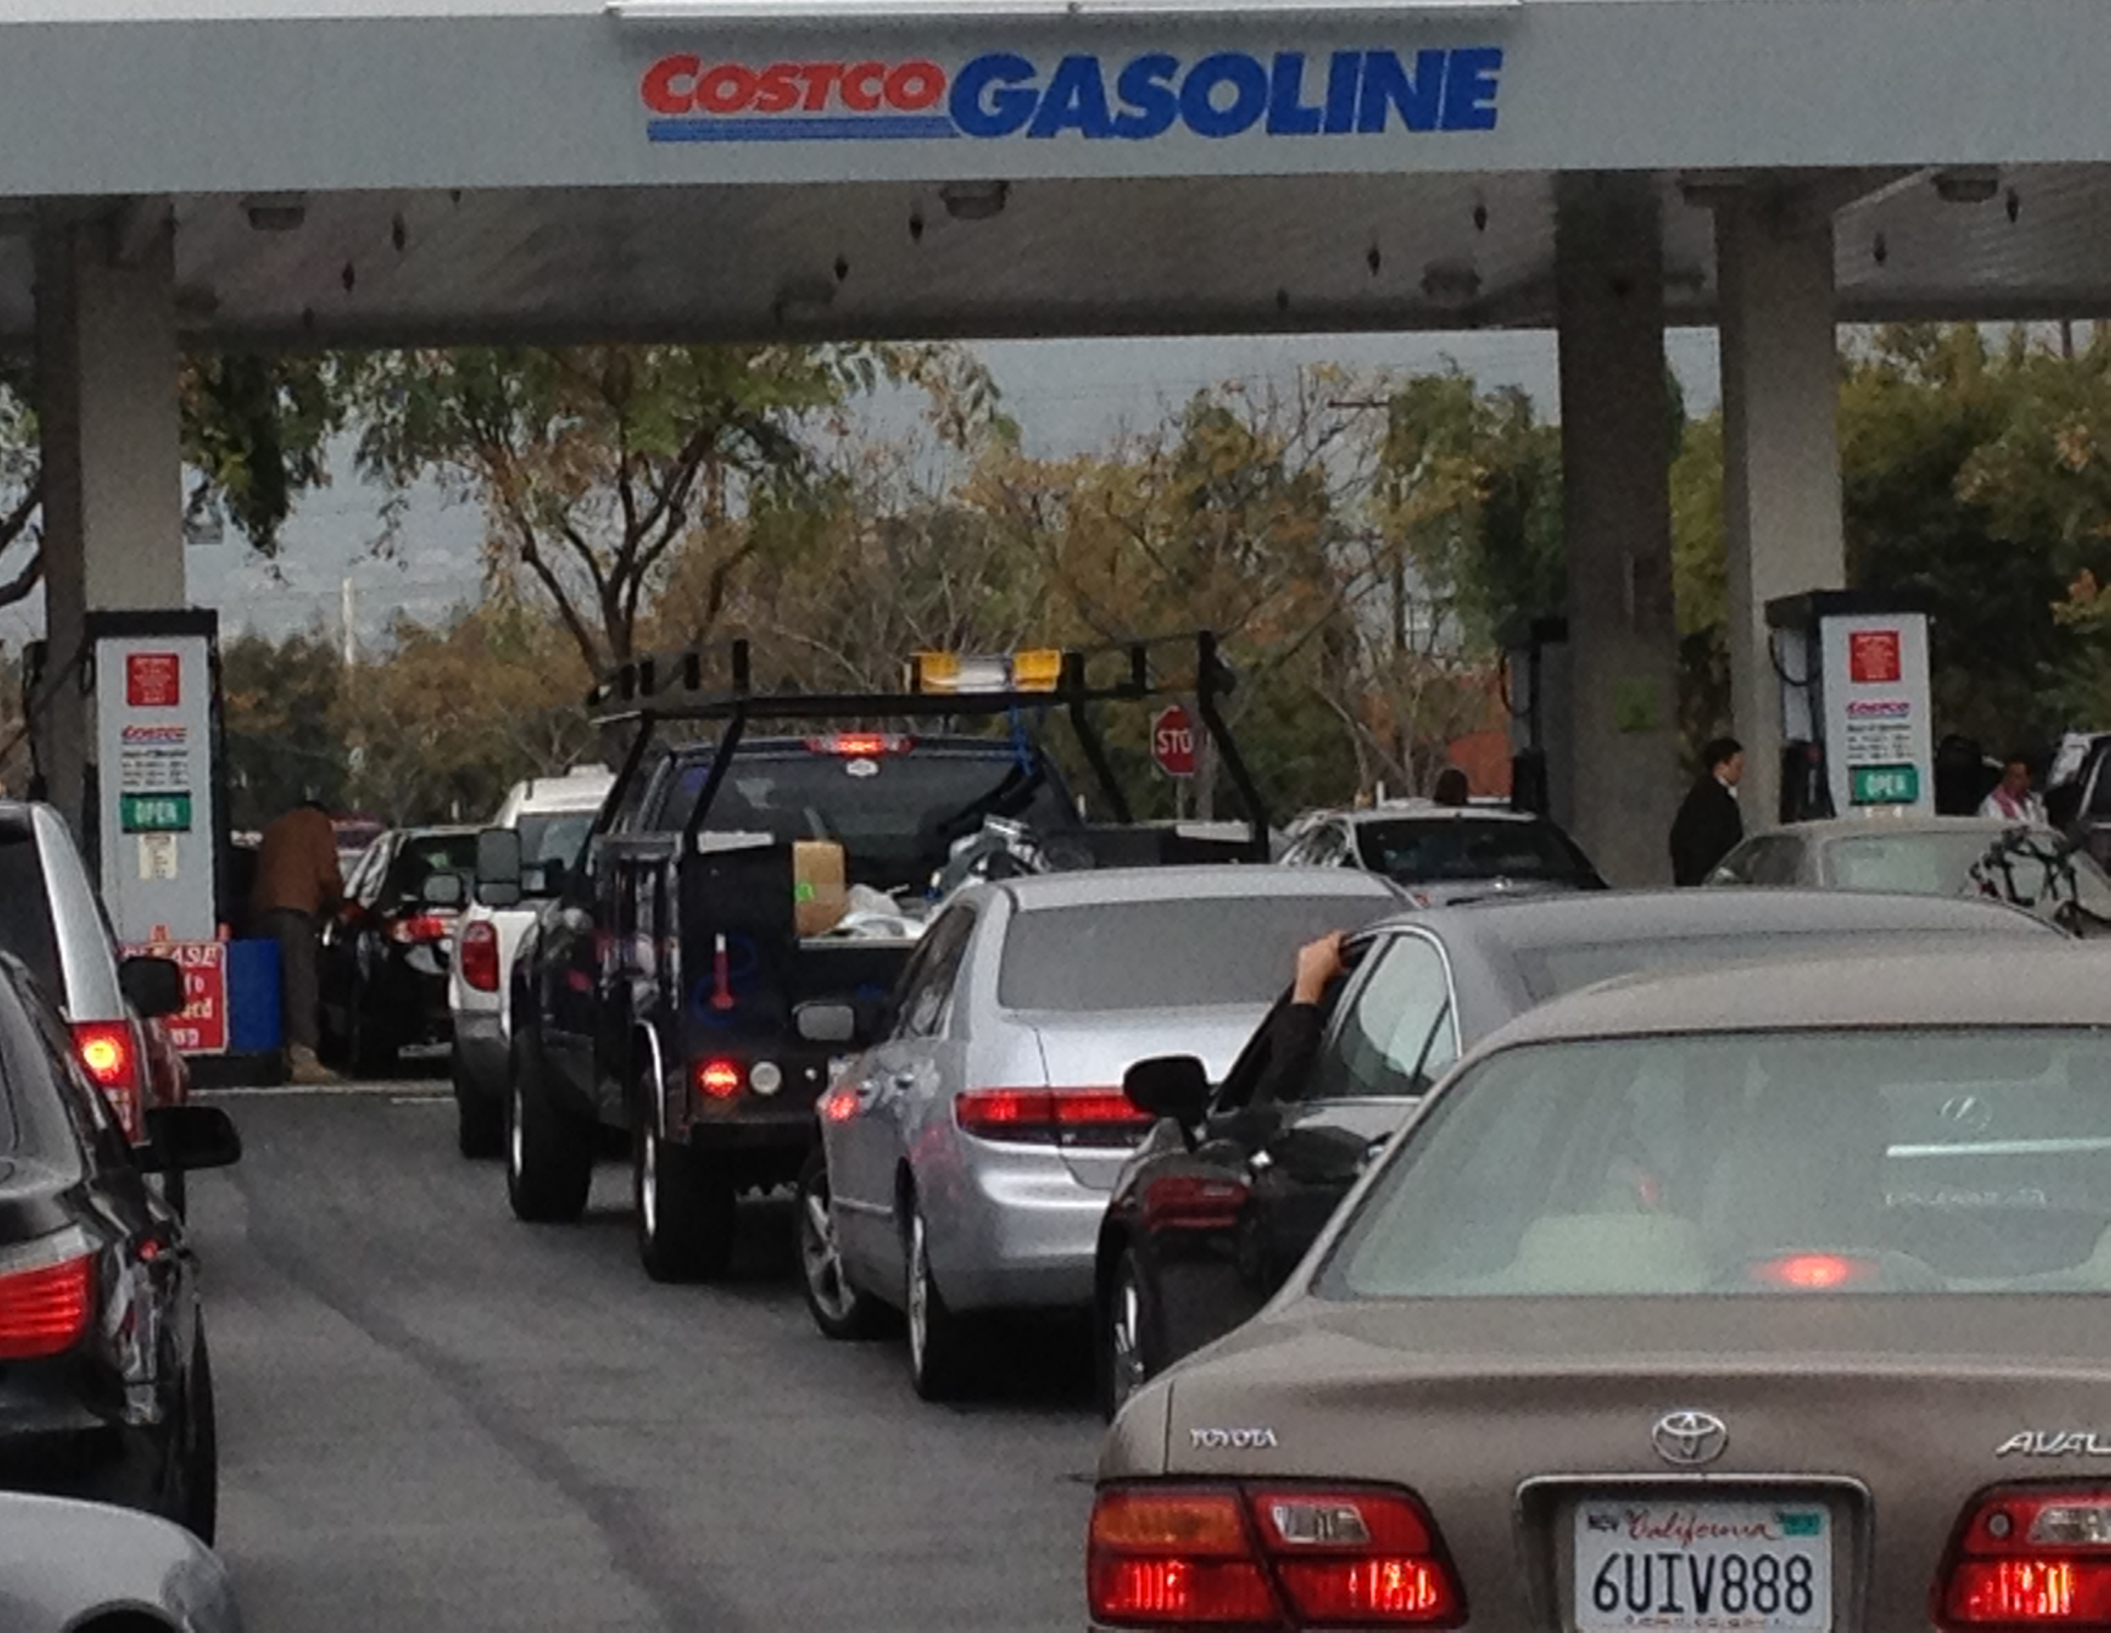
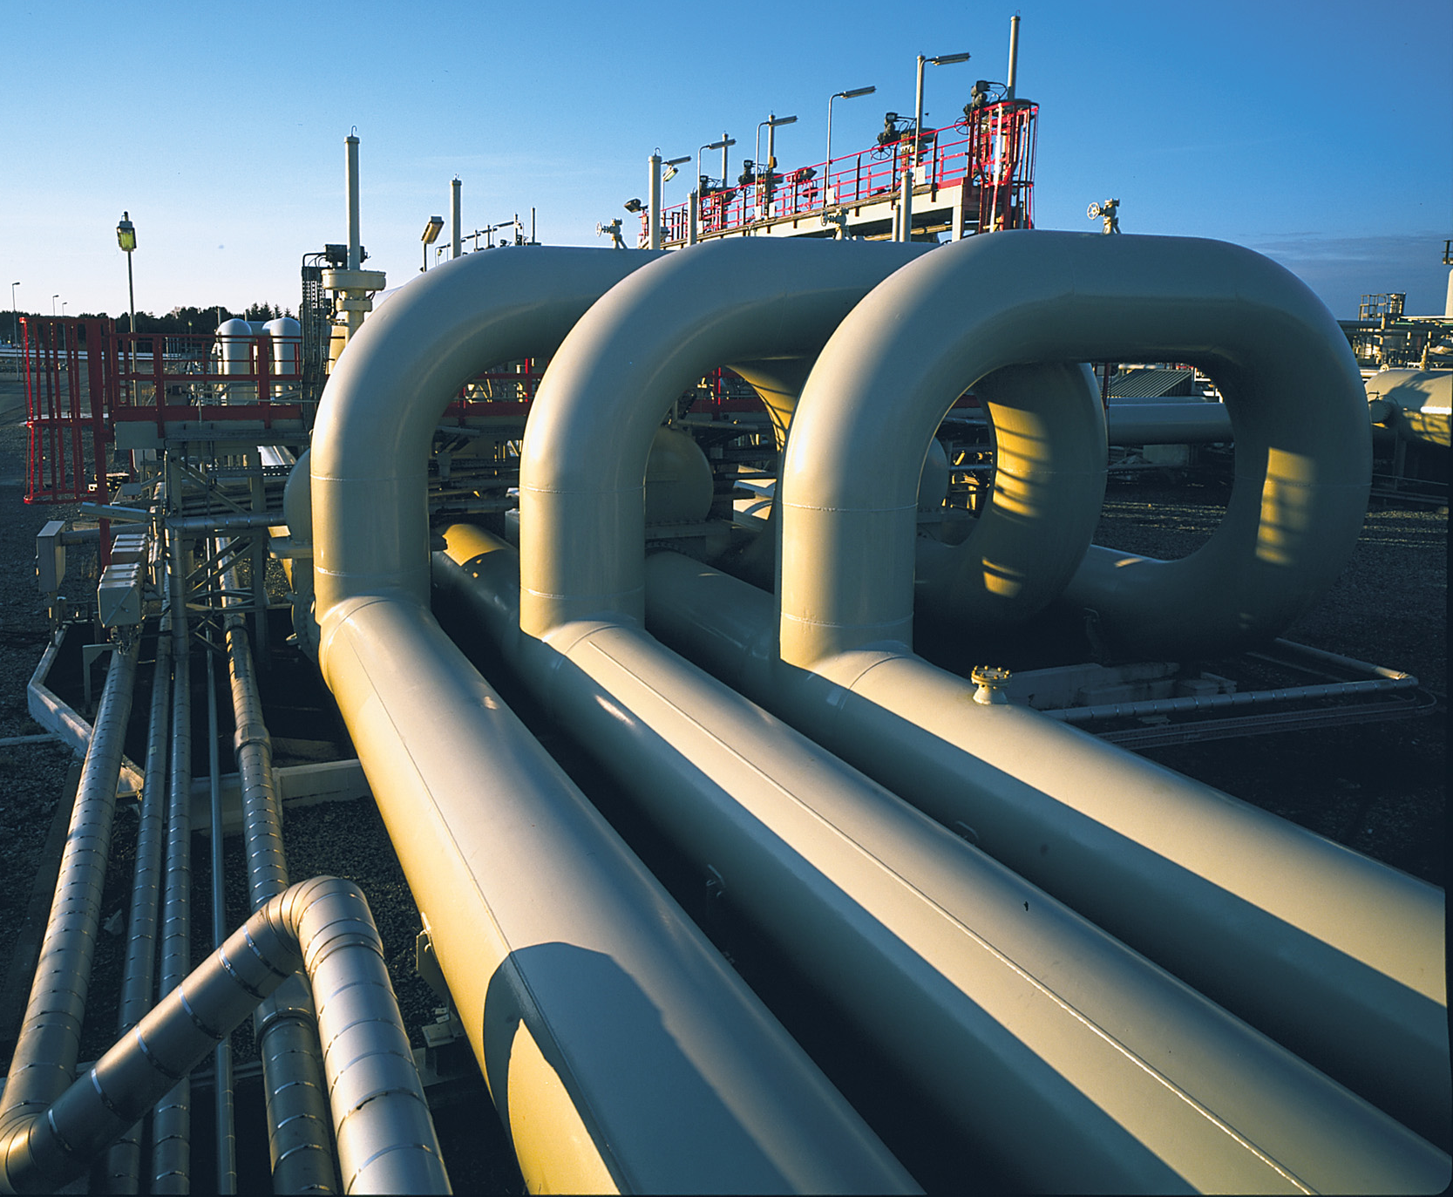
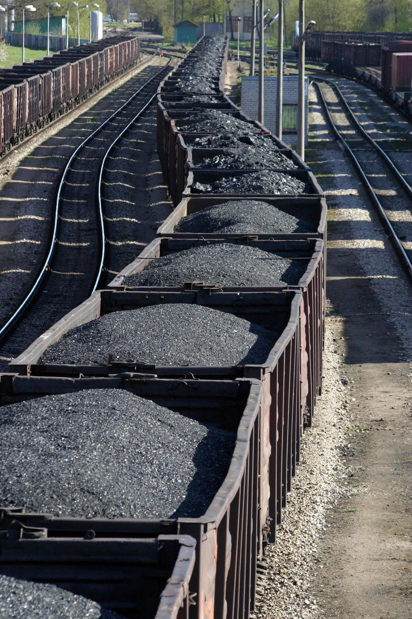
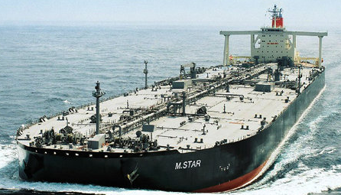
Imagine it’s 1800, and you’re in charge …
Somebody presents you with a grand idea for transforming the world economy:
  Build a system of pipelines, supertankers, railroads, highways, and trucks to deliver it to every street corner on the planet

Slide 51
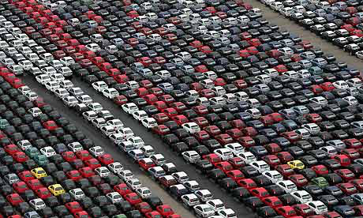
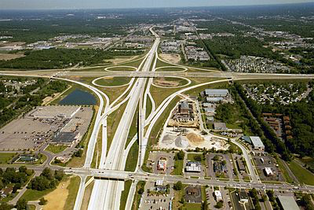
Imagine it’s 1800, and you’re in charge …
Somebody presents you with a grand idea for transforming the world economy:
  Build millions of cars every year, and millions of miles of roads to drive them on

Slide 52
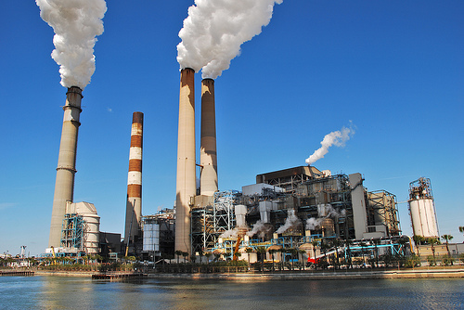
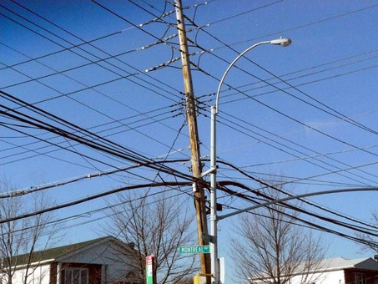
Imagine it’s 1800, and you’re in charge …
Somebody presents you with a grand idea for transforming the world economy:
  Generate and pipe enough electricity to every house to power lights & stereos & LCD TVs

Slide 53

Imagine it’s 1800, and you’re in charge …
Somebody presents you with a grand idea for transforming the world economy:
  Dig 8 billion tons of carbon out of the ground every year
  Build a system of pipelines, supertankers, railroads, highways, and trucks to deliver it to every street corner on the planet
  Build millions of cars every year, and millions of miles of roads to drive them on
  Generate and pipe enough electricity to every house to power lights & stereos & LCD TVs
… “and here’s the itemized bill …”

Slide 54
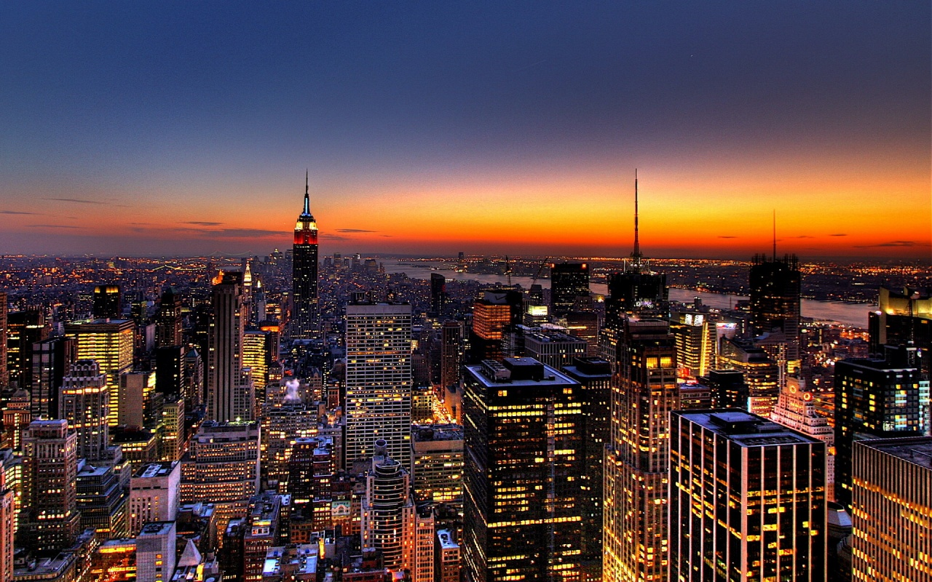
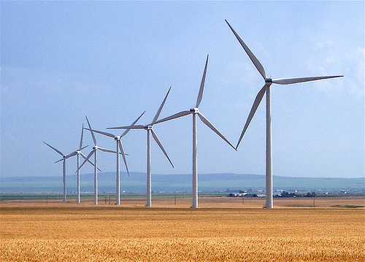
Who Built That?
Our ancestors built that very system
It cost them every dime of global GDP for 200 years (now $78T/yr)
It created every dime too!
Now our kids get to
do it again!

Slide 55

Choose Your Future
Many people think:
  “Our well-being is based on
  stuff we extract from the ground”
When we stop burning coal, will our descendants shiver in the dark?

Slide 56

Choose Your Future
I prefer:
  “We create our well-being through creativity, ingenuity, and hard work”
The future is bright!

