Slide 1
Check your speaker volume—1 of 5
Heating and Warming: Sensitivity of Earth’s Climate to Atmospheric CO₂ September 24, 2012, 6:30 p.m. Eastern time
Introduction for new users: 6:15 p.m. Eastern time
While you’re waiting for the program to begin…
Check your speaker volume with the Audio Setup Wizard
Notes:
[Rotating content from 5:30 to 6:15]
To test your speaker volume, select the audio setup wizard in the top right corner of the Audio & Video box.

Slide 2
Read about the program—2 of 5
Heating and Warming: Sensitivity of Earth’s Climate to Atmospheric CO₂ September 24, 2012, 6:30 p.m. Eastern time
Introduction for new users: 6:15 p.m. Eastern time
While you’re waiting for the program to begin…
Read about today’s topic
In this web seminar, participants will examine Earth's "energy budget" and see how changes in the amount of carbon dioxide in our planet's atmosphere alter global temperatures.
This web seminar introduces several new animations and interactives that can help students understand the Greenhouse Effect and Earth's energy budget on size scales from molecular to global.
Presenters: Scott Denning and Randy Russell
Underwritten by University Corporation for Atmospheric Research (UCAR)
Notes:
[Rotating content from 5:30 to 6:15]
To test your speaker volume, select the audio setup wizard in the top right corner of the Audio & Video box.

Slide 3
Create your profile—3 of 5
Heating and Warming: Sensitivity of Earth’s Climate to Atmospheric CO₂ September 24, 2012, 6:30 p.m. Eastern time
Introduction for new users: 6:15 p.m. Eastern time
While you’re waiting for the program to begin…
Create your Web Seminar profile
Notes:
[Rotating content from 5:30 to 6:15]
To test your speaker volume, select the audio setup wizard in the top right corner of the Audio & Video box.

Slide 4
Register for upcoming programs—4 of 5
Heating and Warming: Sensitivity of Earth’s Climate to Atmospheric CO₂ September 24, 2012, 6:30 p.m. Eastern time
Introduction for new users: 6:15 p.m. Eastern time
While you’re waiting for the program to begin…
Register for upcoming programs
Preparing for NGSS: Developing and Using Models
September 25, 2012
Developing a Competitive Application for the Shell Science Teaching Award
September 26, 2012
Engineering Design Challenge: Water Filtration
October 2, 2012
Read more at http://learningcenter.nsta.org/webseminars
Notes:
[Rotating content from 5:30 to 6:15]
To test your speaker volume, select the audio setup wizard in the top right corner of the Audio & Video box.

Slide 5
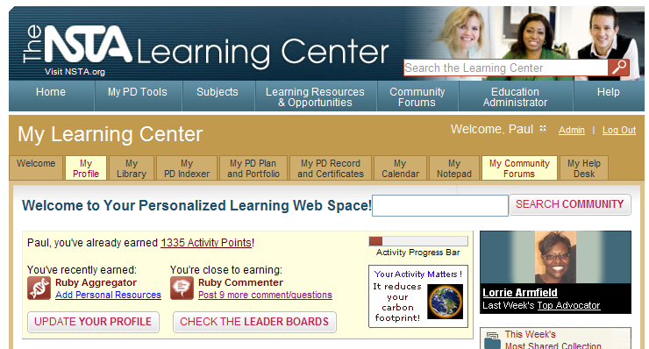
Visit the Learning Center—5 of 5
Heating and Warming: Sensitivity of Earth’s Climate to Atmospheric CO₂ September 24, 2012, 6:30 p.m. Eastern time
Introduction for new users: 6:15 p.m. Eastern time
While you’re waiting for the program to begin…
Visit the NSTA Learning Center
http://learningcenter.nsta.org
Notes:
[Rotating content from 5:30 to 6:15]
To test your speaker volume, select the audio setup wizard in the top right corner of the Audio & Video box.

Slide 6
Title slide—Formal warm up, 6:15 p.m., 1 of 13
LIVE INTERACTIVE LEARNING @ YOUR DESKTOP
Heating and Warming: Sensitivity of Earth’s Climate to Atmospheric CO₂
Presented by: Scott Denning and Randy Russell
September 24, 2012
6:30 p.m. – 8:00 p.m. Eastern time
Notes:
[Before program begins set poll to A-E, set responses to not visible. Under profile, show profiles to everyone.]
Hello everyone and welcome to NSTA Web Seminars, where you can find live interactive learning at your desktop.
My name is {name} and I will be moderating today’s program.
Today’s seminar is part of our {XX} series and it is titled: {title}
Our presenter is {names}.

Slide 7
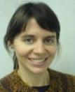
Agenda—2 of 13
Agenda
Audio setup
Tech support
Interactive tools
NSTA Learning Center resources
Presentation
Evaluation
Chat with the presenters
Notes:
Here’s a look at what we’ll cover this evening. First, everyone will have a chance to test their speaker volume, then we’ll go over how to get additional technical help, should you need it. We’ll practice using the web seminar interactive tools and then we’ll talk about how to access additional resources in the NSTA Learning Center. The main presentation will last about one hour and 15 minutes. At the end, you’ll have a chance to provide your feedback by filling out a program evaluation. In exchange for sharing your feedback, you’ll receive a free NSTA SciGuide and a certificate of participation in your Learning Center library. Finally, you’ll have a few minutes to ask any last questions you may have of the presenters.

Slide 8
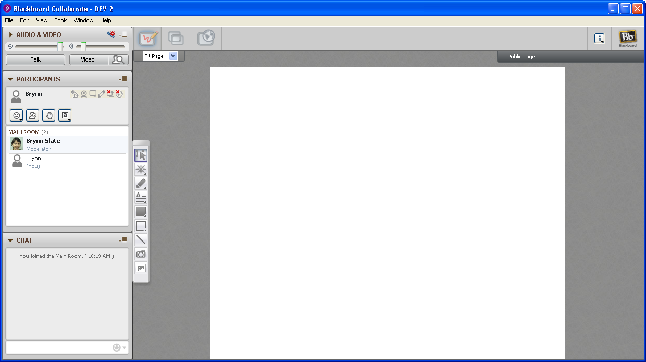
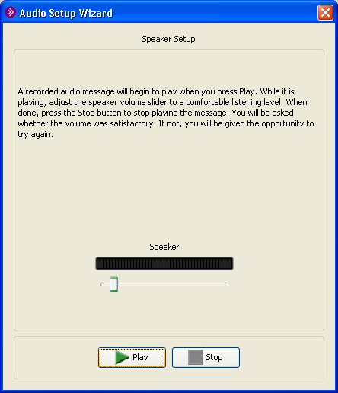
Check your speaker volume—3 of 13
Check your speaker volume
Audio setup wizard
1
2
Notes:
If you haven’t already checked your speaker volume, you can do it now by selecting the audio setup wizard in the top right corner of the Audio & Video box. Then follow the prompts in the window.

Slide 9
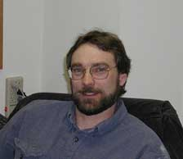
Technical support—4 of 13
Tech Support
Jeff Layman NSTA Technical Coordinator jlayman@nsta.org 703-312-9384
private chat message
For additional tech help call:
Blackboard Collaborate Support,
1-877-382-2293
Notes:
Jeff Layman is available to answer any technical questions you may have during the program. Jeff’s contact information is on the screen and he has posted it in the chat window as well so you can scroll up to it later. You can also send Jeff a private chat message at any time by clicking on his picture in the participant window.
Jeff is only able to help one person at a time so if you need further assistance, you can contact Blackboard Collaborate at the 800 number on the screen. Jeff has also posted that number in the chat window so you can scroll up to it later.

Slide 10
Screen layout—5 of 13
Audio
Adjust your speaker volume
Participants window
Names of moderators and participants
Buttons: emoticons, away, raise hand, polls
Screen marking tools
Virtual pen, text box, clip art
Chat window:
Send messages to the group or to a specific person
Notes:
Here’s an overview of the elements currently on your screen. [Show buttons, tools, chat.]

Slide 11
Using the Chat 6 of 14
Using the Chat
Your questions and ideas
Interact with colleagues
Relevant to topic
Included in archive recording
Continue discussion in community forums
NSTA Learning Center
Notes:
You can use the chat to ask questions, share your own perspective, and hear about what other teachers think of the topic. Remember to keep your comments relevant to tonight’s program because the chat is recorded with the archive of the presentation.

Slide 12
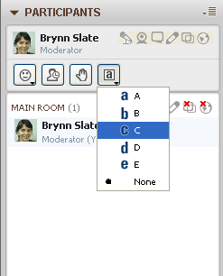
Practice poll—7 of 14
Practice using the tools
Polling buttons
1
2
Notes:
Now let’s practice using the tools. First, we’ll try out the polling buttons. [Explain how to choose answer.]

Slide 13
Poll—8 of 14
What grade level do you teach?
Elementary School, K-5
Middle School, 6-8
High School, 9-12
I teach college students
I am an informal educator
Notes:
Try out the poll buttons with this question. What grade do you teach? [Allow time to respond, then lock poll and publish results to this slide.]

Slide 14
Practice using tools—virtual pen—9 of 14
Practice using the tools
Virtual pen (third button)
Notes:
The virtual pen lets you mark up the presenter’s slides. [Explain how to find and use tool. Practice on this screen.]

Slide 15
Virtual pen graph mark up—10 of 14
Since you’ve been involved with NSTA, how many web seminars have you attended?
Notes:
Try out the virtual pen by marking an X on the graph at the point where the years you’ve been involved with NSTA intersects with the number of web seminars you’ve attended.

Slide 16
Practice using tools—text box—11 of 14
Practice using the tools
Text box (fourth button)
Notes:
The text box tool lets you type a response on the screen. [Explain how to find and use tool. Practice on this screen.]

Slide 17
Text box table—12 of 14
What subjects do you teach?
1.
2.
3.
4.
Notes:
Try out the text box by selecting a row, then typing in the subjects you teach.

Slide 18
Practice using tools—clip art—13 of 14
Practice using the tools
Clip art (bottom button)
Notes:
The clip art tool lets you stamp a picture on the slides. [Explain how to find and use tool. Practice on this screen.]

Slide 19
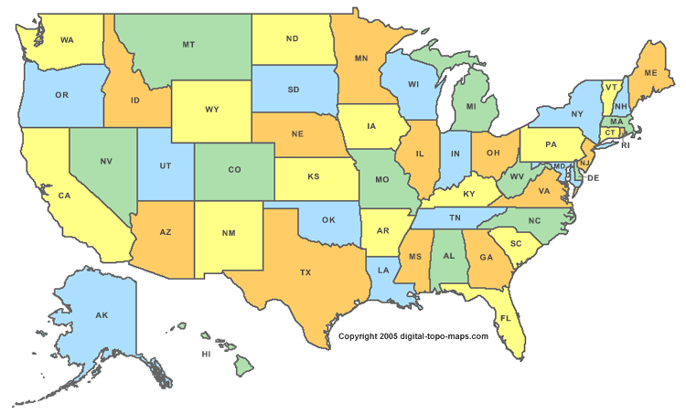
Clip art stamping—14 of 14
Where are you now?
Notes:
Try out the clip art by stamping your location on the map. If you’re outside the U.S. you can use the text box tool to type in your location. [Wait for stamping.]
That’s the end of our warm up so now we’re going to start the presentation.

Slide 20
Start recording—title slide—1 of 3
LIVE INTERACTIVE LEARNING @ YOUR DESKTOP
Heating and Warming: Sensitivity of Earth’s Climate to Atmospheric CO₂
Presented by: Scott Denning and Randy Russell
September 24, 2012
6:30 p.m. – 8:00 p.m. Eastern time
Notes:
[***Start recording.***]
Welcome to NSTA Web Seminars, where you can find live interactive learning at your desktop.
My name is {name} and I will be moderating today’s program.
Today’s seminar is part of our {XX} series and it is titled: {title}
Our presenter is {names}.

Slide 21
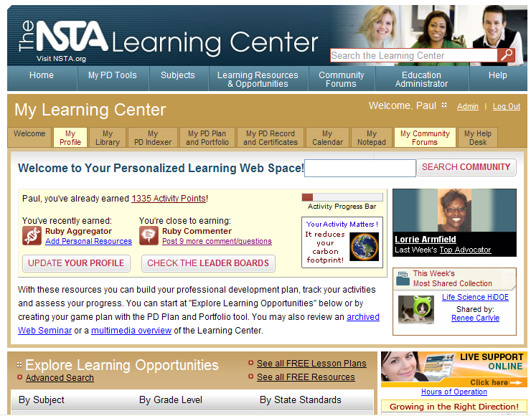
NSTA Learning Center—2 of 3
http://learningcenter.nsta.org
Notes:
Web seminars are just one type of resource you can find in the NSTA Learning Center, your online portal for professional learning and over 9,500 resources for science educators.

Slide 22
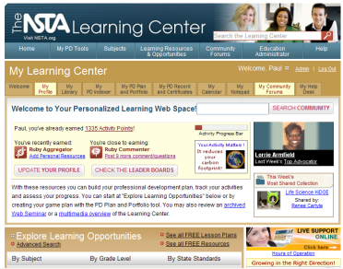
About the NSTA Learning Center—3 of 3
NSTA Learning Center
9,500+ resources
3,200+ free!
Add to “My Library” to access later
Community forums
Online advisors to assist you
Tools to plan and document your learning
http://learningcenter.nsta.org
Notes:
Everyone logged on to the web seminar today has a Learning Center account, which means you have access to these resources, including over 3,200 that are free. You don’t have to be an NSTA member in order to add resources to your library to save and use later in your professional learning and lesson planning. You also have access to the community forums where you can discuss content and pedagogical issues with other teachers. Later, we’ll share a link to a forum where you can continue the conversation from tonight’s web seminar. Our online advisors are available via live chat to help you find the information you’re looking for. And to help you organize your own professional development, track your goals, and show your progress, you can use the My PD Plan and Portfolio tool. Visit the Learning Center to continue your professional learning.

Slide 23
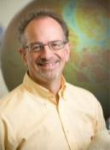
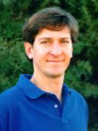
Introducing today’s presenters
Introducing today’s presenters…
Scott Denning
Colorado State University
Center for Multiscale Modeling of Atmospheric Processes
Randy Russell
Spark, National Center for Atmospheric Research
Notes:
Now I’d like to introduce today’s presenters. [Give name and brief bio.]

Slide 24
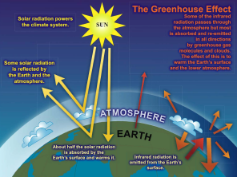
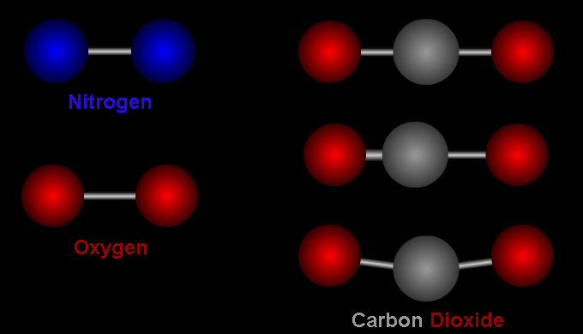
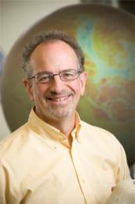
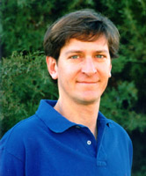
Heating and Warming: Sensitivity of
Earth’s Climate to Atmospheric CO₂
Randy Russell
Scott Denning
Notes:
Webinar Topic Intro

Slide 25
Scott Denning
Professor of Atmospheric Science at Colorado State University
Director of Education, Center for Multiscale Modeling of Atmospheric Processes (CMMAP)
BS in Geology, PhD in Atmospheric Science
Notes:
Scott’s introduction

Slide 26
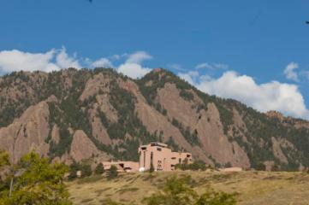
Randy Russell introduction
Randy Russell
Lead web & interactive multimedia developer at Spark in Boulder, Colorado
Spark is the science education group at the National Center for Atmospheric Research (NCAR)
BS astrophysics, MS aerospace engineering, PhD in education
Notes:
Randy Russell introduction

Slide 27
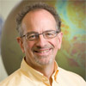
Understanding and Prediction:
Modeling the Earth System
This is the second in a series of four webinars in which we will use very simple models to explore the way the Earth’s climate works and how it’s changing.
Teaching Climate with Models: Breathing of the Earth (June 11, 2012 – archived)
Heating and Warming: Sensitivity of Earth’s Climate to Atmospheric CO₂
Challenges for Our Children: Projections of the future of Earth’s climate and carbon cycle
Opportunities for Abundance: Solving the problems of energy, carbon, and climate
Notes:
Webinar series overview

Slide 28
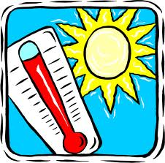
Ever Wonder Why?
Day is warmer than night
Summer is warmer than winter
Miami is warmer than Minneapolis
Notes:
Ever wonder why?

Slide 29
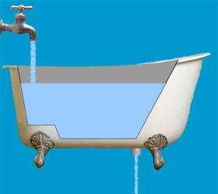
Heat Budgets
Heat in
Heat in
Heat out
Heat out
Notes:
Heat budgets

Slide 30
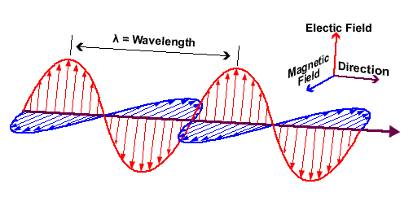
Electromagnetic Radiation
Travels through space at 186,000 miles / sec!
Distance in one cycle is called the wavelength
Changing electric fields create changing magnetic fields … and vice versa!
This makes energy move across space
We can see it & feel it … it warms and cools the Earth
Notes:
EM radiation

Slide 31
Electromagnetic Spectrum
Shorter waves carry more energy than longer waves
Radiation interacts with matter at similar scales (sizes) as the waves
Notes:
EM spectrum

Slide 32
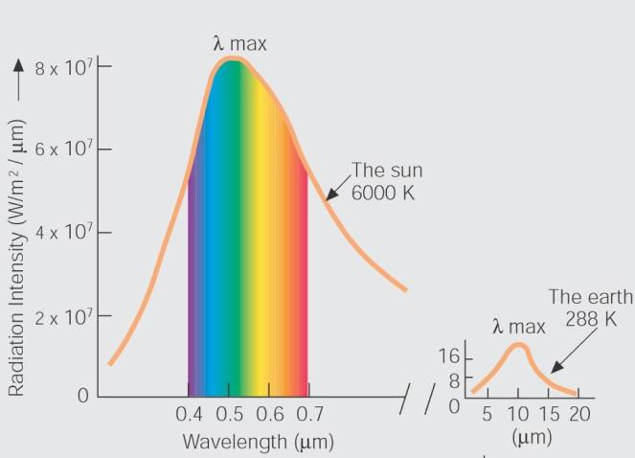
Emission Spectra of the Sun & Earth
The hot sun radiates at shorter (visible) wavelengths that carry more energy
The cooler Earth radiates absorbed solar energy at longer (thermal) wavelengths
Notes:
Sun & Earth emission spectra

Slide 33
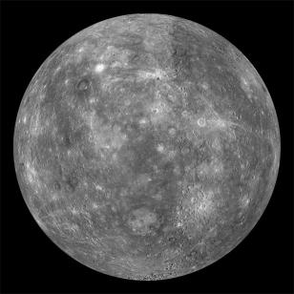
Poll: Which gives off longer wavelength infrared radiation:
hot Mercury or
cold Pluto?
Pluto surface temperature:
as low as -400 °Fahrenheit
Mercury surface temperature:
up to 800 °Fahrenheit
Notes:
Poll: Mercury vs Pluto IR

Slide 34
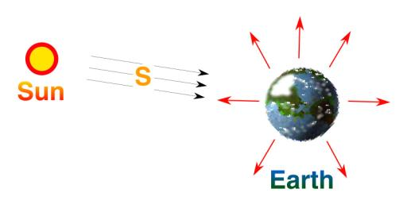
Planetary Heat Balance
Heat In = Heat Out
Absorbed solar energy in = emitted thermal energy out
Notes:
Planetary heat balance 1

Slide 35
Planetary Heat Balance
Heat In = Heat Out
Absorbed solar energy in = emitted thermal energy out
HEAT IN: S * (1-albedo) * area of Earth’s shadow = HEAT OUT: Thermal emission * area of Earth’s surface
area of Earth’s surface = 4πR²
Notes:
Planetary heat balance 2

Slide 36
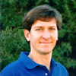
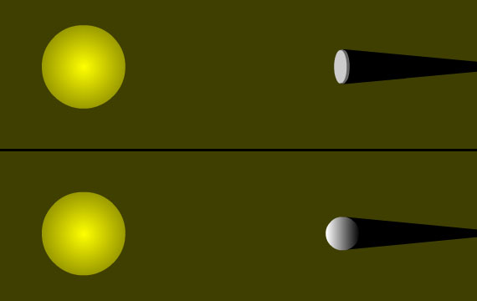
Energy In vs. Energy Out
We can think of Earth as a circle when calculating sunlight absorbed
We must treat Earth as a sphere when calculating energy emitted
Notes:
Earth disk vs sphere

Slide 37
Planetary Heat Balance
HEAT IN: S * (1-albedo) * area of Earth’s shadow
Earth’s albedo (reflected fraction) = 30% area of Earth’s shadow = πR²
HEAT IN:
Notes:
Planetary heat balance 3

Slide 38
Planetary Heat Balance
HEAT OUT: Thermal emission * area of Earth’s surface
Thermal emission is very sensitive to temperature
Thermal emission is proportional to T⁴ = T x T x T x T
area of Earth’s surface = 4πR²
HEAT OUT:
Notes:
Planetary heat balance 4

Slide 39
Planetary Heat Balance
T = 255 °Kelvin
= -18 °Celsius
= 0 °Fahrenheit
Brrrrrr!
Notes:
Planetary heat balance 5

Slide 40
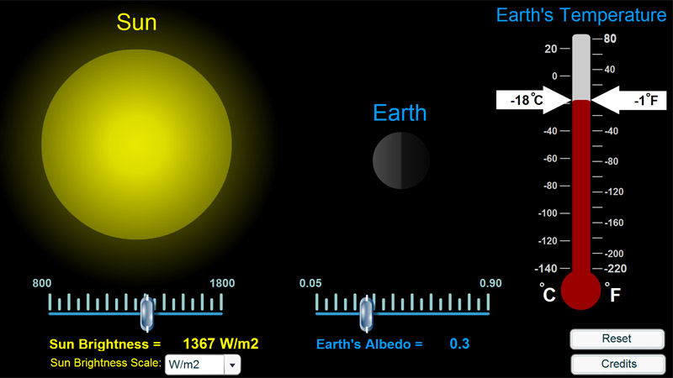
Interactive: Earth’s Energy Balance
Notes:
Interactive: Earth energy budget

Slide 41
Questions?
Notes:
Questions?

Slide 42
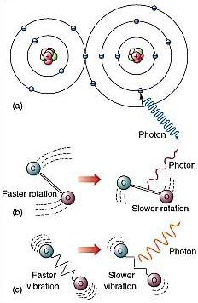
Atoms, Molecules, and Photons
Atmospheric gases are made of molecules
Molecules are groups of atoms that share electrons (bonds)
Photons can interact with molecules
Transitions between one state and another involve specific amounts of energy
Notes:
Atoms, molecules, photons

Slide 43
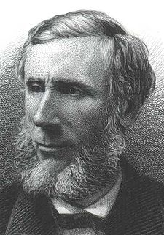
Absorption and Emission of Heat by CO₂ Gas in the Laboratory
Absorption and emission of thermal radiation by CO₂ gas was first measured in 1863
Since that time, the measurements have been made thousands of times, with better and better instruments
Results show that doubling CO₂ in the atmosphere would add 4 Watts of heat to every square meter of Earth
John Tyndall, January 1863
Notes:
John Tyndall

Slide 44
Notes:
Greenhouse effect

Slide 45
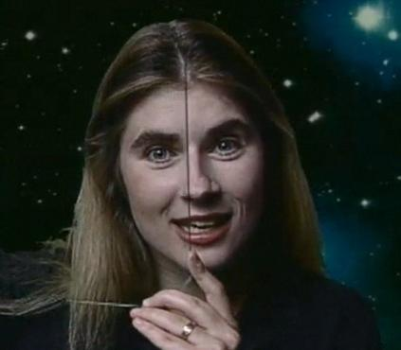
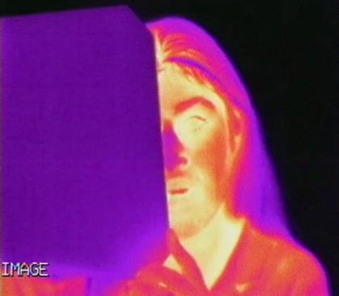
Transparency and Opacity:
Infrared vs. Visible Light
Notes:
IR vs visible: pane of glass

Slide 46
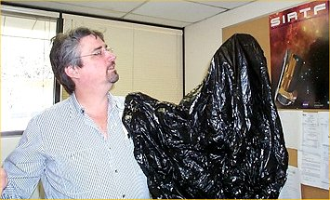
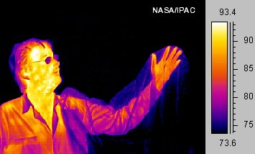
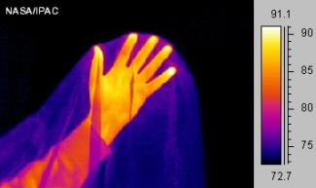
Transparency and Opacity:
Infrared vs. Visible Light
Notes:
IR vs visible: plastic bag

Slide 47
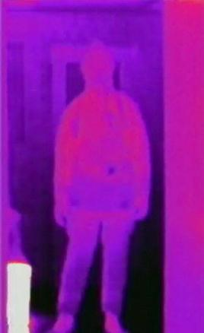
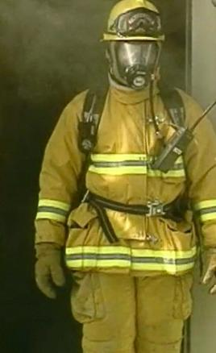
Transparency and Opacity:
Infrared vs. Visible Light
Notes:
IR vs visible: smoke

Slide 48
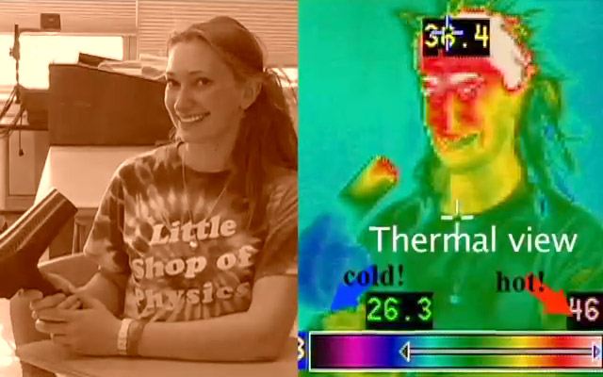
Hot (Dry) Air is
NOT Visible in the Infrared
Notes:
Hair dryer IR

Slide 49
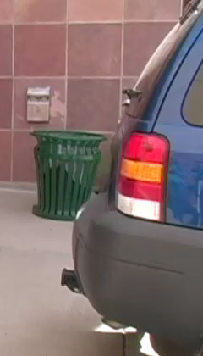
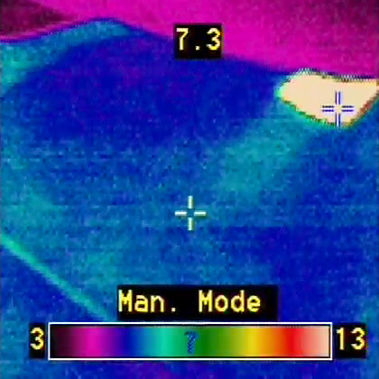
Hot Car Exhaust (with lots of CO₂) IS Visible in the Infrared
VERY hot
tailpipe
Hot exhaust
with lots
of CO₂
Notes:
Car exhaust IR

Slide 50
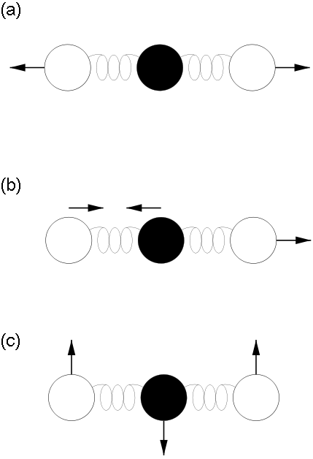
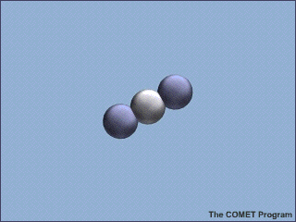
Molecular Vibration Modes and the Greenhouse Effect
Notes:
GHG vibration modes

Slide 51
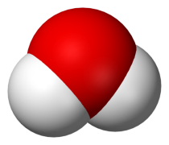
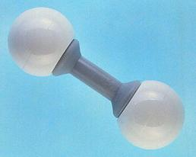
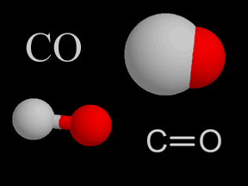
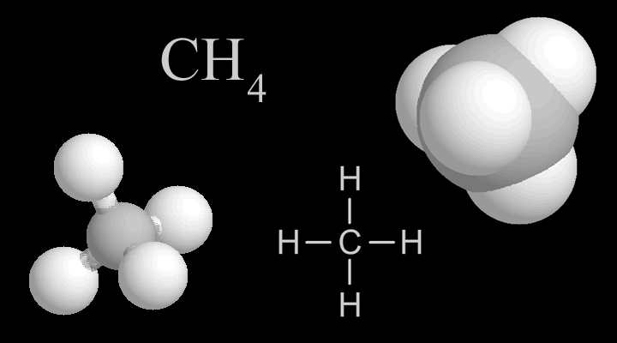
Poll: Which is NOT a GHG molecule?
A) Water vapor
C) Hydrogen
B) Carbon
monoxide
D) Methane
Notes:
Poll: not GHG molecule

Slide 52
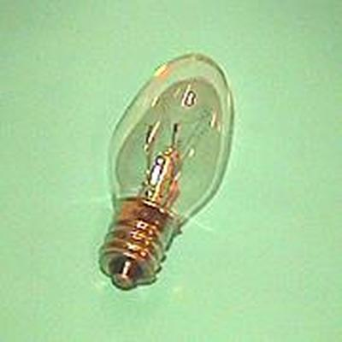
Heat and CO₂ in Earth’s Climate
Doubling CO₂ in the atmosphere would add 4 Watts of heat to every square meter of Earth
The extra heat would be applied 24 hours a day, 365 days a year
That would make the Earth’s surface warmer
This has been known since 1863
4 Watts
1 m
Notes:
Heat & CO2 in Earth’s climate

Slide 53
Climate Forcing, Response, and Sensitivity
Forcing
(change in sunshine)
Response:
(Change in Surface Temperature)
“Let’s do the math …”
Notes:
Climate forcing 1

Slide 54
Climate Forcing, Response, and Sensitivity
Forcing
(change in sunshine)
Response:
(Change in Surface Temperature)
Doubling CO₂ adds 4 W m⁻² to the Earth’s surface
If everything else stayed the same, adding 4 W m⁻² would warm the surface by about 1 °C (1.8 °F)
Notes:
Climate forcing 2

Slide 55
Climate Forcing, Response, and Sensitivity
Forcing
(change in sunshine)
Response:
(Change in Surface Temperature)
Doubling CO₂ adds 4 W m⁻² to the Earth’s surface
If everything else stayed the same, adding 4 W m⁻² would warm the surface by about 1 °C (1.8 °F)
BUT everything else wouldn’t stay the same!
Notes:
Climate forcing 3

Slide 56
Climate Feedback Processes
DS
DT_{S}
Notes:
Climate feedback 1

Slide 57
Climate Feedback Processes
Positive feedbacks amplify the changes
We know there are positive feedbacks because tiny changes in heat in and out have produced Ice Ages and other climate changes in the past!
How do they work?
DS
DT_{S}
Notes:
Climate feedback 2

Slide 58
Climate Feedback Processes
Positive feedbacks amplify the changes
More water evaporates from a warmer surface
Water vapor is a strong greenhouse gas
Extra water vapor warms the surface even more
DS
DT_{S}
Dvapor
Notes:
Climate feedback 3

Slide 59
Climate Feedback Processes
Positive feedbacks amplify the changes
Warmer surface has less ice and snow (darker)
A darker surface absorbs more incoming sunshine
Darker surface warms
DS
DT_{S}
Dvapor
D albedo
Notes:
Climate feedback 4

Slide 60
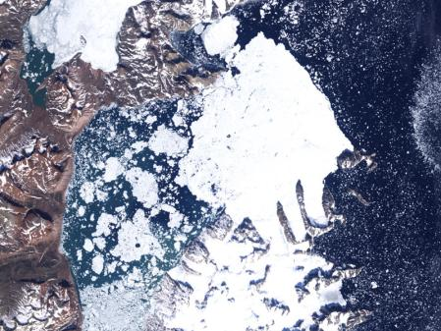
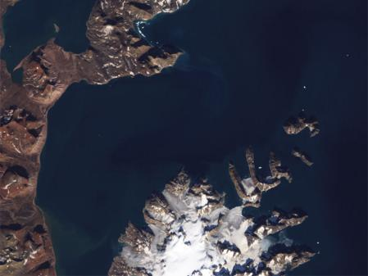
Ice Albedo Feedback
Satellite (LANDSAT) images of the coast of Greenland in August 1985 (left) and September 2002 (right) show how ice reflects much more sunlight than water. Melting ice causes more absorption of energy from sunlight, leading to further warming.
Notes:
Ice albedo feedback

Slide 61
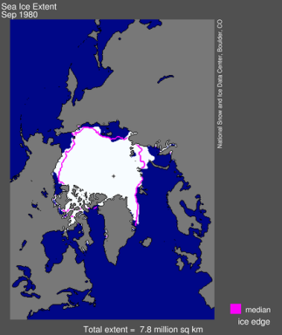
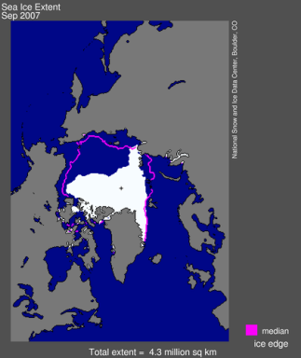
Sea Ice Decline in the Arctic
The amount of sea ice in the Arctic has been declining dramatically in recent decades, as seen here in 1980 (left) and 2007 (right).
Notes:
Declining sea ice

Slide 62
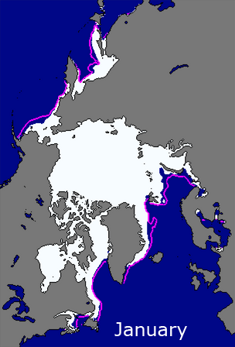
Graphing Sea Ice Extent Activity
… and animations and interactive viewer.
Notes:
Graphing sea ice activity

Slide 63
Climate Feedback Processes
Positive feedbacks amplify the changes
Some of the extra water vapor turns into high clouds
High clouds block some outgoing thermal radiation
High clouds warm the surface even more
D hi cloud
DS
DT_{S}
Dvapor
D albedo
Notes:
Climate feedback 5

Slide 64
Climate Feedback Processes
Negative feedbacks reduce the changes
We know there are negative feedbacks because the climate has not “run away”
Liquid water has always existed throughout geologic time
How do they work?
D hi cloud
DS
DT_{S}
Dvapor
D albedo
Notes:
Climate feedback 6

Slide 65
Climate Feedback Processes
Negative feedbacks reduce the changes
Some extra water vapor turns into extra low clouds
Low clouds block sunlight, but don’t block as much outgoing thermal energy
Extra low clouds cool the surface
D hi cloud
D lo cloud
DS
DT_{S}
Dvapor
D albedo
Notes:
Climate feedback 7

Slide 66
High vs. Low Clouds
Different Effect on Climate
Notes:
Clouds: high vs low

Slide 67
Satellite Views of Clouds in
Visible Light and Infrared
Satellite views of clouds over Panama in April 2000 show how low and high clouds have different impacts on climate. Image on left is visible light; only shows low clouds. Infrared image on right also shows high cirrus clouds.
Notes:
Clouds: visible vs IR

Slide 68
Climate Feedback Processes
Negative feedbacks reduce the changes
Warmer surface emits more thermal radiation
Extra thermal emission cools the surface
D hi cloud
D LW
D lo cloud
DS
DT_{S}
Dvapor
D albedo
Notes:
Climate feedback 8

Slide 69
Climate Feedback Processes
Positive Feedbacks (amplify changes)
Water vapor
Ice-albedo
High clouds
Negative Feedbacks (reduce changes)
Low clouds
Extra emission
D hi cloud
D LW
D lo cloud
DS
DT_{S}
Dvapor
D albedo
Notes:
Climate feedback 9

Slide 70
Questions?
Notes:
Questions

Slide 71
Learning from the Past
Bright surface reflected 3.4 W m⁻² extra sunlight
Lower Ice Age CO₂ allowed 3.7 W m⁻² extra thermal emission to space
Notes:
Learning from past 1

Slide 72
Learning from the Past
Ice Age surface heat balance was about (3.4 + 3.7) = 7.1 W m⁻² less
Ice Age surface temperature was about 5 ° C colder (about 9 °F)
After Ice Age, extra 7.1 W m⁻² heat warmed surface by 5 °C
Total Climate Sensitivity about 0.7 °C per W m⁻²
Notes:
Learning from past 2

Slide 73
Climate Sensitivity to CO₂
Doubling CO₂ in the atmosphere would add 4 Watts of heat to every square meter of Earth
Climate sensitivity with all positive and negative feedbacks = 0.7 °C per W m⁻²
Climate sensitivity to doubling CO₂ is about (4 W m⁻²) x (0.7 °C per W m⁻²)
4 Watts
1 m
Climate Sensitivity about 3 °C per doubling of CO₂
Notes:
Climate sensitivity CO2

Slide 74
Climate Sensitivity Calculator
Notes:
Interactive: Climate sensitivity calculator

Slide 75
Questions?
Notes:
Questions

Slide 76
Thanks to today’s presenters
Thanks to today’s presenters!
Scott Denning
Randy Russell
Notes:
I’d like to thank today’s presenters…

Slide 77
Thank you to the sponsor of tonight’s web seminar—1 of 6
Thank you to the sponsor of today’s web seminar:
This web seminar contains information about programs, products, and services offered by third parties, as well as links to third-party websites. The presence of a listing or such information does not constitute an endorsement by NSTA of a particular company or organization, or its programs, products, or services.
Notes:
Thank you to [organization] for sponsoring tonight’s program.

Slide 78
Thank you to NSTA administration—2 of 6
National Science Teachers Association
Gerry Wheeler, Interim Executive Director
Zipporah Miller, Associate Executive Director, Conferences and Programs
Al Byers , Ph.D., Assistant Executive Director, e-Learning and Government Partnerships
Flavio Mendez, Senior Director, NSTA Learning Center
NSTA Web Seminars
Brynn Slate, Manager
Jeff Layman, Technical Coordinator
Notes:
Thank you to the administration of NSTA for their support for web seminars.

Slide 79
Upcoming web seminars—3 of 6—stop recording
Upcoming Programs
Preparing for NGSS: Developing and Using Models
September 25, 2012
Developing a Competitive Application for the Shell Science Teaching Award
September 26, 2012
Engineering Design Challenge: Water Filtration
October 2, 2012
Register at http://learningcenter.nsta.org/webseminars
Notes:
You can register for upcoming programs by visiting learningcenter.nsta.org/webseminars
[Read dates and titles.] We look forward to seeing you again on another NSTA web seminar. Thank you, everyone, for your participation.
[***Stop recording.***]

Slide 80
Archive reminder—4 of 6
View this program again!
Within 48 hours, you’ll receive an email with a link to access:
Recording of the program
Learning Center Collection
PowerPoint slides
Resources (websites, videos, etc.)
Related discussion in Community Forums
Notes:
Within the next few days, you will receive an email with links to access the archive of this program and the Learning Center collection, which will contain the PowerPoint slides, all the resources covered, and a link to one of our Community Forums where you can continue the discussion from tonight.

Slide 81
Evaluation—5 of 6
Program Evaluation
Click on the URL in the chat window
Take as long as you need
In exchange for completing the evaluation, you will receive:
A certificate of attendance
NSTA SciGuide ($6 value)
Please allow two weeks for your materials to arrive in your Learning Center library
Notes:
Now we’d like to ask for your feedback. Jeff has placed the link for the evaluation in the chat window. You can take as long as you need to complete the survey, but after five minutes you’ll hear a timer, which means we’re coming back for a few final minutes of informal Q and A with the presenter.

Slide 82
Final questions—6 of 6
Informal Q&A with the presenters
Notes:
If you have any final questions for the presenter, please enter them into the chat window now.

